Slide 1
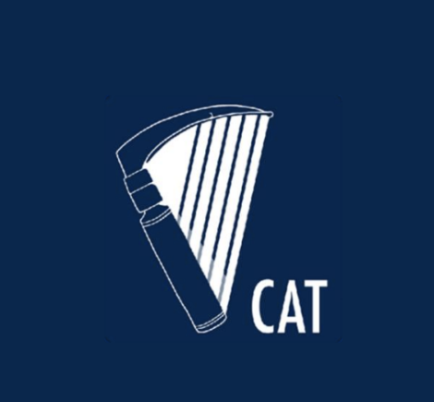


CAT NEWS
December 2022
INSIDE THIS ISSUE
SAT 7
We hear from Dr. Niall Tierney about his SAT 7 year working in Crumlin Children’s hospital
Thinking about postgraduate study?
Find out what Dr. Mohammed Ahmed Rasheed thought about his Masters in Clinical Research
Interested in volunteering abroad?
Dr. Hanin Hamza shares her experience working with Global Emergency Care skills
Autumn Social and Wellbeing Event
Have a look at some of the photos from our yacht party

Slide 2

CONTENTS
Editor’s Note Page 3
SAT 7 Page 4
Postgraduate education Page 6
Volunteering with Global Emergency Care Skills Page 9
CAT Social Page 15
ISRA updates Page 19
LAT news Page 20
e-LA RCOA Page 22
GASOC updates Page 23
Support services Page 24
Available Resources
Wellbeing Resources
Dates for your Diary Page 26
Exams Page 28

Slide 3

Editor’s note
Dr. Maeve O’Brien and Dr. Siobhán Clarke
Co-Editors CAT news
Welcome to the December edition of CAT news!
We hope you are enjoying the start of festive season and getting excited for Christmas! Only five more sleeps!!
We are very excited to share this jam-packed edition with you! First up, we would like to thank everyone who made it to our Autumn Social and Wellbeing Event in October. The turn out was seriously impressive and It was great catching up with friends from far and wide. Turn to page 15 to find out what went on and to see if you made it into any of the photos. Make sure to watch this space for future social outings!
We would like to thank Dr. Niall Tierney for submitting a fantastic piece about his SAT 7 experience in Crumlin Children’s Hospital. We would also like to thank both Dr. Mohammed Ahmed Rasheed and Dr. Hanin Hamza for their contributions to this edition. Dr. Rasheed completed a Masters in Clinical Research in the University of Galway and Dr. Hamza travelled to Kenya during her year out after SAT 2. We’re sure they’ll inspire many others to follow in their footsteps.
Dr. Fiona Roberts has informed us that she will be stepping down from her position as the Irish Anaesthetic Representative for GASOC. If you’re interested in this role read on to find out more!
As usual we have some of your good news stories from the various hospital sites around the country and we also have some important dates for your diary.
If there is anything you’d like featured in CAT news going forward don’t hesitate to let us know. We’re always delighted to receive feedback and advice. Get in touch via twitter, facebook or email!
We wish you all the best over the Festive period and a Happy New Year!
cat@coa.ie
@AnaesTrainees
Committee of Anaesthesia Trainees Facebook Page
Previous CAT NEWS Editions (anaesthesia.ie)

Slide 4
Specialist Anaesthesia Training (SAT) Year 7
The aim of SAT 7 is to help secure more senior experience for trainees and offload the pressure intrinsic to a trainee trying to fulfil their senior on call experience requirement and gain training in a new subspecialty within a six-year programme.
Options for SAT 7 include Intensive Care Medicine (ICM) (Beaumont, MMUH, SJH, SVUH, CUH, TUH, UHG), Perioperative medicine (SVUH), Pain medicine (TUH, SJH), Paediatric anaesthesia/ ICM (Crumlin), Regional Anaesthesia (UHG), Cardiothoracics (MMUH), Obstetric anaesthesia (Dublin/ Galway).
Each subspeciality, not to mention each centre will ascribe different roles and responsibilities to their SAT 7 however the overall emphasis is on leadership and preparatory work for consultant practice.
We ask Dr. Niall Tierney to tell us about his experience of SAT 7 for those considering applying in future.

Slide 5
SAT 7 experience
Dr. Niall Tierney
PICU and Anaesthesia, Crumlin Children’s Hospital
With a love of paediatric anaesthesia and a desire to stay in Ireland for another year post CCST a SAT 7 fellowship seemed like a great idea. Paeds anaesthesia consultant jobs generally require at least 2 years of post-CCST paediatric experience so a SAT 7 year is unlikely to remove the need to go abroad entirely.
Crumlin offers two posts – one in paediatric anaesthesia and one in PICU. After the standard SAT 7 application there was a common interview for both posts with representatives of the anaesthetic and PICU departments after which I was offered the anaesthetic job.
The day to day role is largely similar to that of an SpR. Crumlin is a busy department with a nice mix of “normal” paeds surgery and the more weird and wonderful stuff that comes with being a national referral centre. As the fellow I generally had a say in what lists I was assigned and was able to pull rank if there were interesting cases coming up. Paeds is more intensely supervised than adult anaesthesia but as with anywhere this is largely dependent on the individual consultant and so there were opportunities for solo practice and plenty of scope for developing my skills.
The post has a full on call commitment as it is not supernumerary. Anyone who has worked in Crumlin before will know this means lots of PICU call as there is generally a dearth of senior trainees who have done paeds before. Until staffing levels are increased this is unlikely to change.
I enjoyed my SAT 7 year. The caseload and level of complexity you will see in Crumlin is significant. The consultants are generally supportive and are open to developing the role of the SAT 7 fellow which is very much in its infancy. There is also an understanding that the SAT 7 fellowship will be held in the same regard by a future interview panel as an international fellowship although I have yet to test this.
Any questions please contact me by email. nttierney@gmail.com

Slide 6

Postgraduate Education
More and more trainees are enrolling in postgraduate courses. From Certificates to Masters, the choice is endless. But deciding whether to further your study and what to study next can be a very daunting task.
In this upcoming series, we ask SAT trainees about their experience in postgraduate education to better equip those hoping to pursue a similar path.
Notes:
Should we include something about levels? Level 6 – level 10

Slide 7
Masters in Clinical Research - University of Galway
Dr. Mohammed Ahmed Rasheed
Out of programme after SAT 2 - Paediatric critical care, Royal London Hospital
The Masters in Clinical Research (MCR/MSc) at the University of Galway (formerly NUI Galway) is an excellent choice for trainees looking to improve their ability to understand and perform clinical research. It has a broad target audience, including healthcare workers new to research, or clinicians looking to improve and diversify their research interests.
The structure of this Masters programme is similar to other level 9 courses. It can either be completed over 2 years as a part time course, or 1 year as a full time student. I undertook the course during SAT1 and SAT2 as a part time student - and found this quite manageable. There are usually one or two assignments a week, and one or two tutorials weekly. Since COVID-19 lockdowns, the entire course has been transformed to accommodate online learning. The course remains largely accessible online for most modules. In person teaching is available, but very rarely compulsory. Lectures and tutorials are recorded for future reference and available through the online blackboard.
The course follows the European Credit Transfer System (ECTS), where 90 credits are required for successful completion of the Masters programme. Students are awarded 10 points per module, and 30 points for a research thesis. In essence, either 9 individual modules, or 6 modules and a research thesis are required.
Year 1 consists of 2 semesters. Semester 1 consists of 3 compulsory modules; fundamentals of research, ethics and an introduction to biostatistics. In semester 2, students choose 3 modules of their liking. These include, but are not limited to, advanced biostatistics, observational study analysis, systematic reviews, biobank ethics and methodology for randomised trials.
Assessments for the modules include continuous assessments in the form of assignments, and most modules have an end of term exam. The module examinations are mostly manageable and not particularly challenging.

Slide 8
Having chosen systematic review, observational studies and the two statistics modules, I found them very important in improving my understanding of published research and were vital in helping me perform recent projects. In particular, my comprehension and appreciation for data analysis has vastly improved.
The thesis component of the Masters programme can either be self organised, or you have the option of joining one of the college’s professors in their on-going work. My thesis was self organised - and allowed me to collaborate with a researcher at the Manchester Royal Infirmary. The course tutors are very happy to facilitate this and offer a plethora of support during your thesis write up. Periodic evaluation of progress, academic writing classes and access to librarian services such as help with search strategies, are all available through the postgraduate school.
The programme gives you the resources required to perform good quality research and allowed me to perform my first systematic review and meta-analysis as part of my thesis.
As future consultants, analysing and critically appraising medical research is essential to keep up to date with developments in our speciality. The Masters in Clinical Research at the University of Galway is a fantastic programme to help you develop skills as a researcher. However, I believe its true value lies in giving trainees the tools to become confident in assessing potential practice changing research - a crucial skill for the modern consultant.

Slide 9
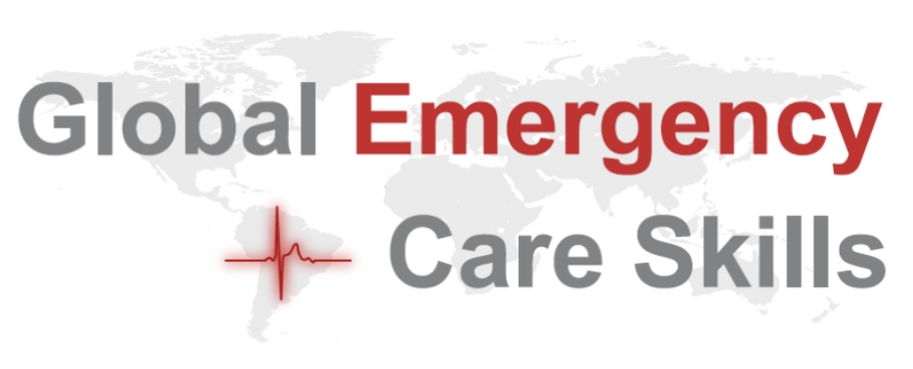
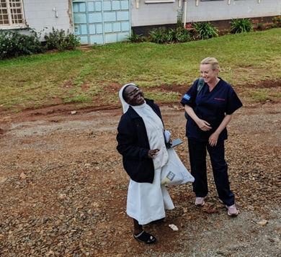
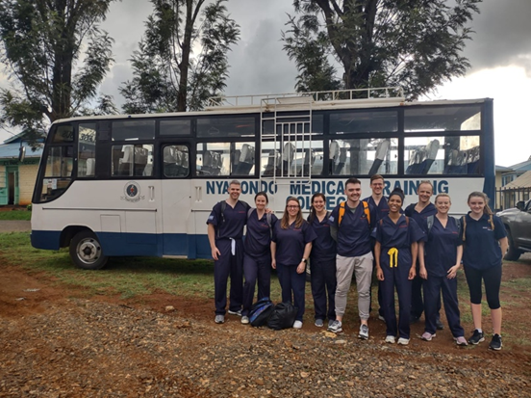
A week in Nyabondo, Kenya with Global Emergency Care Skills (GECS)
Dr. Hanin Hamza
Out of programme after SAT 2
I’m a trainee in Anaesthesiology and I’m currently taking leave out of the SAT programme, between SAT 2 and SAT 3. I feel immensely privileged to be able to take this time away to forge new experiences. In November this year, I travelled to Kenya with a medical non-profit charity organisation called Global Emergency Care Skills (GECS). GECS was founded in 2008 by Prof. Jean O’Sullivan, consultant in Emergency Medicine at Tallaght University Hospital, with the purpose of providing training courses to healthcare staff in low and middle income countries.
The GECS faculty was led by Prof. Jean O’Sullivan and Dr. Robert Eager and was otherwise composed of another trainee in Anaesthesiology, Siobhán Clarke, Emergency Medicine consultants and trainees, a medical trainee and a transition year student on work experience. Together we visited St. Joseph’s Nyabondo Missionary Hospital in Nyabondo, Kenya. There we delivered a 5-day training course focusing on the management of medical emergencies and trauma, using a combination of didactic teaching and simulation training.
L. Sr. Arnolda with Prof. O’Sullivan R. GECS faculty

Slide 10
St. Joseph’s Nyabondo is, at present, an 80-bed hospital with an emergency room, inpatient wards, a maternity ward, laboratory services and an operating theatre. Additionally, the hospital provides outpatient services such as nutritional services, HIV care and reproductive health education. Alongside other rural hospitals, St. Joseph’s Nyabondo serves the surrounding 6 counties with a combined population of approximately 4 million people. We were invited to teach at St. Joseph’s Nyabondo because in the coming months, a new Trauma Centre is due to be opened on the site. The hospital director wrote to medical charities, one of whom was GECS, requesting emergency and trauma training provision for staff in St. Joseph’s Nyabondo and neighbouring hospitals.
I was surprised to learn upon our arrival, that very few of the staff undertaking the course (and managing emergencies in St. Joseph’s Nyabondo on a daily basis) were doctors. In fact, there are only 3 doctors contracted to work in the entire hospital regularly, 2 of whom (ideally) would be on-site in a given 24 hour period. There is a paucity of medical graduates throughout Kenya and much of Africa, therefore many of the tasks that would be carried out by doctors back home would instead be performed by clinical officers or nursing staff. Clinical officers complete a 3 year university degree and are employed in a role similar to doctors however with a limited scope of practice. Of the 35 course participants, 2 were doctors and the remainder were a mix of clinical officers and nurses.
The course that we delivered was based around the World Health Organisation’s Basic Emergency Care course. Given the imminent upgrade of St. Joseph’s Nyabondo into a regional Trauma centre, we also chose to emphasise trauma management, dedicating 2 days of the course to delivering trauma lectures designed by the GECS group and conducting trauma simulation sessions. Additionally, throughout the course we were able to incorporate airway teaching.

Slide 11
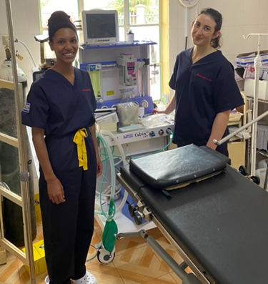
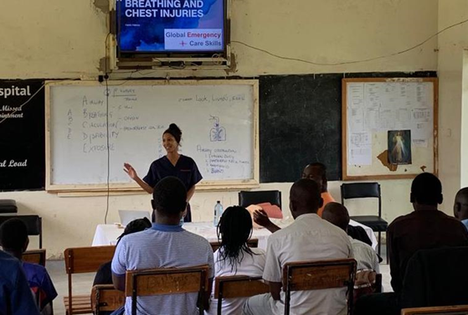
I found it incredibly touching how motivated each and every person who attended the course was. Keeping lectures and simulation sessions within their allotted time was difficult due to the sheer number of questions the attendees had. It was very apparent how much they valued this opportunity for learning. The hospital security staff were also keen to take an opportunity to up-skill, eagerly partaking in a workshop on the safe immobilisation and transport of the trauma patient. Later in the week speaking to Kennedy, one of the doctors participating, I found out that healthcare workers in Kenya usually have to take unpaid leave from work to attend any educational courses and in fact, this had precluded many members of staff from other hospitals who had signed up from actually attending this course.
Not keen on disproving the Anaesthetist stereotype, as soon as we arrived at St. Joseph’s Nyabondo, Siobhán and I were hoping to get a tour of the operating theatre. We were soon introduced to Chris, a clinical officer specialising in Anaesthesiology, who is the only member of the Anaesthesia team based in St. Joseph’s Nyabondo full-time. There is also an Anaesthetist (a doctor) available at times for procedures in theatre and he works between several hospitals in the region. However hearing from Chris (and seeing the theatre logbook) the ‘Anaesthetist’ is most often not a doctor. Chris showed us around the theatre and talked us through the equipment and medications available to him. Suffice to say, anaesthetic practice in rural Kenya is an exercise in doing quite a lot with very little

Slide 12
On the Wednesday of our week in Nyabondo, Siobhán and I were invited to observe an emergency Caesarean section, with the mother’s consent. A significant proportion of deaths at St. Joseph’s Nyabondo are due to maternal and neonatal causes with 54% of deaths in this hospital attributed to communicable, maternal and neonatal disease. In theatre, Chris explained to us that he performs low dose spinals for Caesarean sections unless contra-indicated. However he clarified that availability of vasopressors in the hospital is severely limited and that he has no access to phenylephrine, ephedrine or noradrenaline. Notably, there is no neonatal resuscitation station in the theatre. We watched the surgery with bated breath. Mother and baby came through and when Siobhán and I visited them on the maternity ward the next day, they were thriving. The unfortunate reality is that that is too often not the case and unsurprisingly in the course feedback, participants requested training in Obstetric emergencies in future.
After teaching was finished on our third day, we visited the Nyabondo Centre for Persons with Disabilities. As Sr. Ludavena led us through the centre, I was struck by how the religious sisters took their passion for helping the disadvantaged and built a loving home for children with disabilities, many of whom had been abandoned by their families and society. Sr. Arnolda, a nurse who now works in an antenatal clinic told me: “this is still where my heart is”. As well as being a home, the centre has teamed up with AMREF, the Flying Doctors of East Africa, to perform Orthopaedic and Reconstructive surgeries that change the lives of their children. The centre in Nyabondo provides rehabilitation services with charity funded-physiotherapy, occupational therapy and even production of prostheses on-site. Additionally, the sisters provide vocational training in the centre, teaching skills that can enable their children to live independent adult lives. A description can’t fully encapsulate the feeling of being there and seeing the impact that the co-ordinated work of medical charities can make to a community or a group of people in need

Slide 13
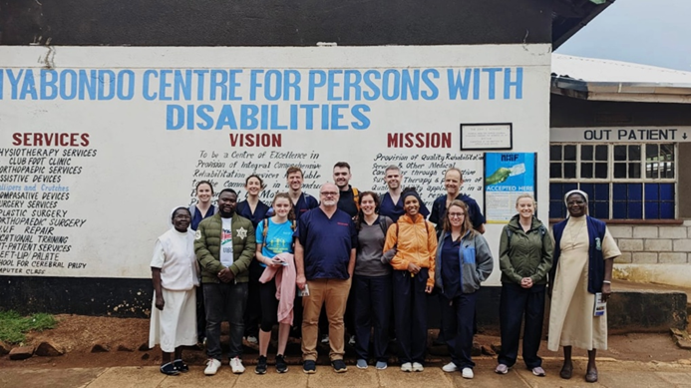
GECS faculty with Sisters Arnolda, Ludavena and R.N Churchill
I feel so fortunate to have had the experience of travelling to Kenya with GECS. Reflecting on my experience now, I feel like a naïve version of myself boarded the plane in Dublin airport, knowing that we were headed to an under-resourced African hospital but not having a frame of reference for it. The week was a steep learning curve. The entire GECS faculty showed an immense amount of versatility, adapting the course along the way to ensure that the knowledge imparted could be put to real-world use by participants with the resources available to them.
It was so fulfilling hearing and reading feedback from the people who attended the teaching sessions. At the close of the course one of the participants, Mike, gave an emotional speech to thank both the GECS faculty and those who attended. He reflected on previous practice in their various hospitals and opined that the training that we provided, such as a systematic (ABCDE) approach to managing emergencies will help to save lives in future. It was a particularly poignant moment in my week that I’m not embarrassed to say brought tears to my eyes. A nurse who attended the course, Denis, summarised: “As per now, I am very confident I can manage a patient in trauma. I have the capacity”.
Close to my heart (and I’m sure to Siobhán’s) was the airway teaching and simulation component of the course. Siobhán delivered an airway lecture at the outset of the course. Over the following days, together we conducted airway simulation sessions in small groups which proved very popular with the course participants. Notably, in a questionnaire designed by the GECS group, 58% of the attendees indicated that they had no previous airway training however 63% had been involved in clinical situations which required emergency airway management. The happy ending to this story is that 100% of attendees reported feeling more confident in their airway skills following this GECS course.

Slide 14
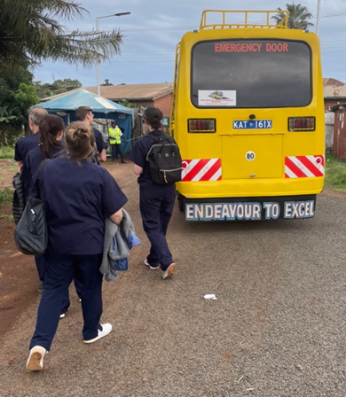
One key aim of the GECS group was to ensure that sustained teaching and delivery of life saving skills could continue in future. As part of this effort, the 5th and final day of the course was devoted to training the trainer. Course lectures were made available to the hospital’s clinical director and the equipment and mannequins donated by GECS will make simulation training possible into the future at St. Joseph’s Nyabondo.
Prayer and gratitude were all around us in Nyabondo. The course began and ended with staff nurse Rose leading the attendees in prayer, to thank God for granting them this opportunity for learning. I’m thankful for the people who volunteered to join the GECS faculty and the wonderful group that I got to meet and work with. I’m thankful for the friends, family, hospitals and businesses in Ireland that donated money and equipment to make this trip possible. I will be more appreciative in future for the training opportunities I have in life, for the mentorship and guidance that’s so readily available to me, for end-tidal CO2 monitoring in theatres, and for working in hospitals that can afford propofol, vasopressors, a defibrillator and more than one laryngoscope. I’m so grateful for the fulfilment and the personal growth this trip with GECS has given me and I would thoroughly recommend the experience to anyone who is tempted by the prospect.
For more information on GECS: https://iaem.ie/international/gecs-22
(dedicated website in development)
Twitter: @GlobEmergCare
Instagram: @globalemergencycareskills

Slide 15
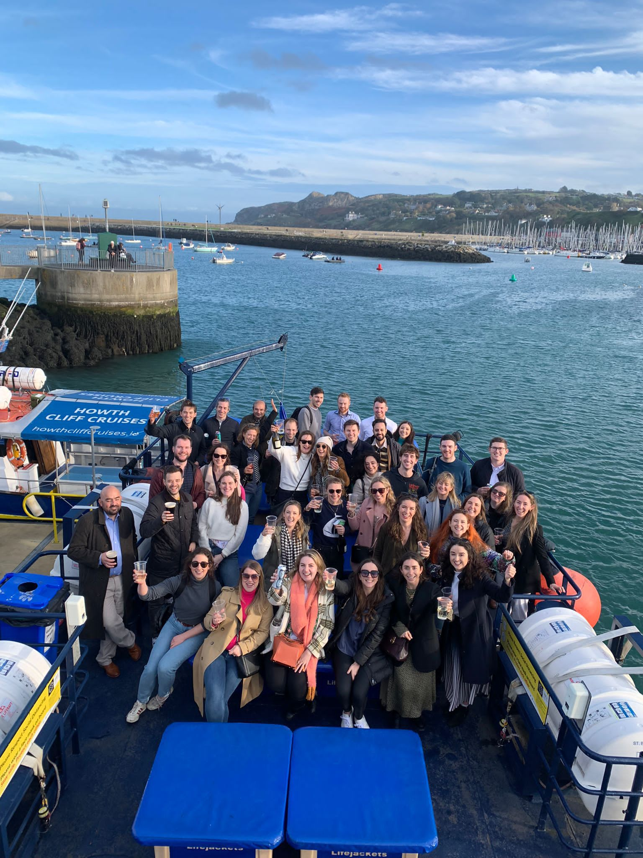

CAT Social
Dr. Maeve O’Brien
Party Like a Lob - Star
This year, we at CAT decided to treat you to a very special Autumn Social and Wellbeing Event and unless you’ve been living under a rock, you’ll know it was our CAT Yacht Party!
A ravishingly good-looking group of trainees travelled from around the country and met outside the Ferryman pub to wait for the boat to take us up the Dublin Riviera!! We were welcomed by the crew of the double decker yacht and off we went down the Liffey and headed for the open sea! We thankfully had a hearty serving of pints and prosecco (both served by the pint glass!) to help to steady the nerves as we made our way through the waves to Howth. Even a few dolphins stopped by to see if they could get in on the action.
Keen to continue the party once we arrived in Howth, we strolled up to McNeils where we tucked into some delicious food. We even managed a joint birthday celebration for Gill Crowe and Eanna O’Sullivan (rumour has it, that this event was really a birthday party for them in disguise!)
As soon as we were fed and watered we bundled onto the DART / Dorsh (whatever your inclination) and made the journey back to the city. In true anaesthetic trainee style, we settled into the Gingerman for the night!
Thanks to everyone who joined us! Already looking forward to seeing you all at next year’s social event!

Slide 16
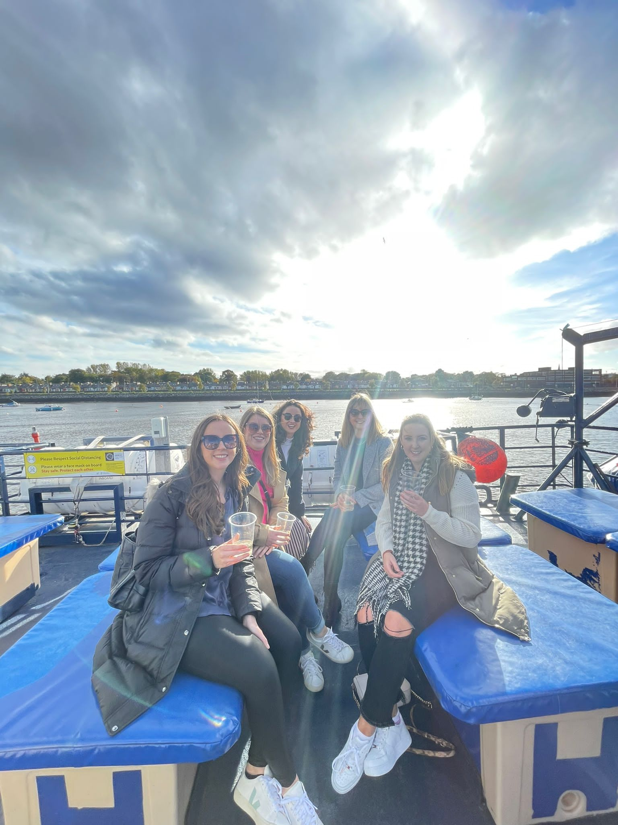
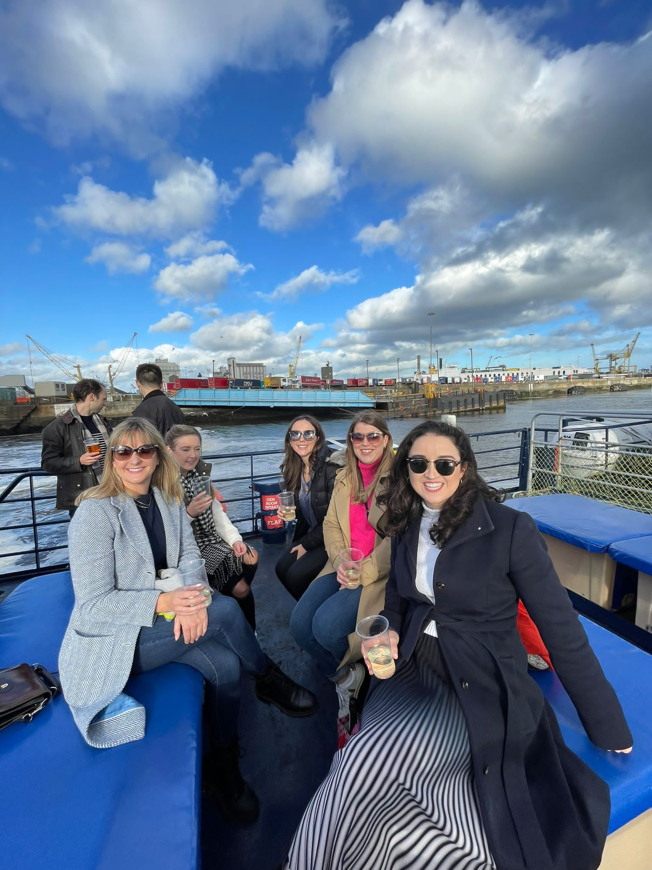

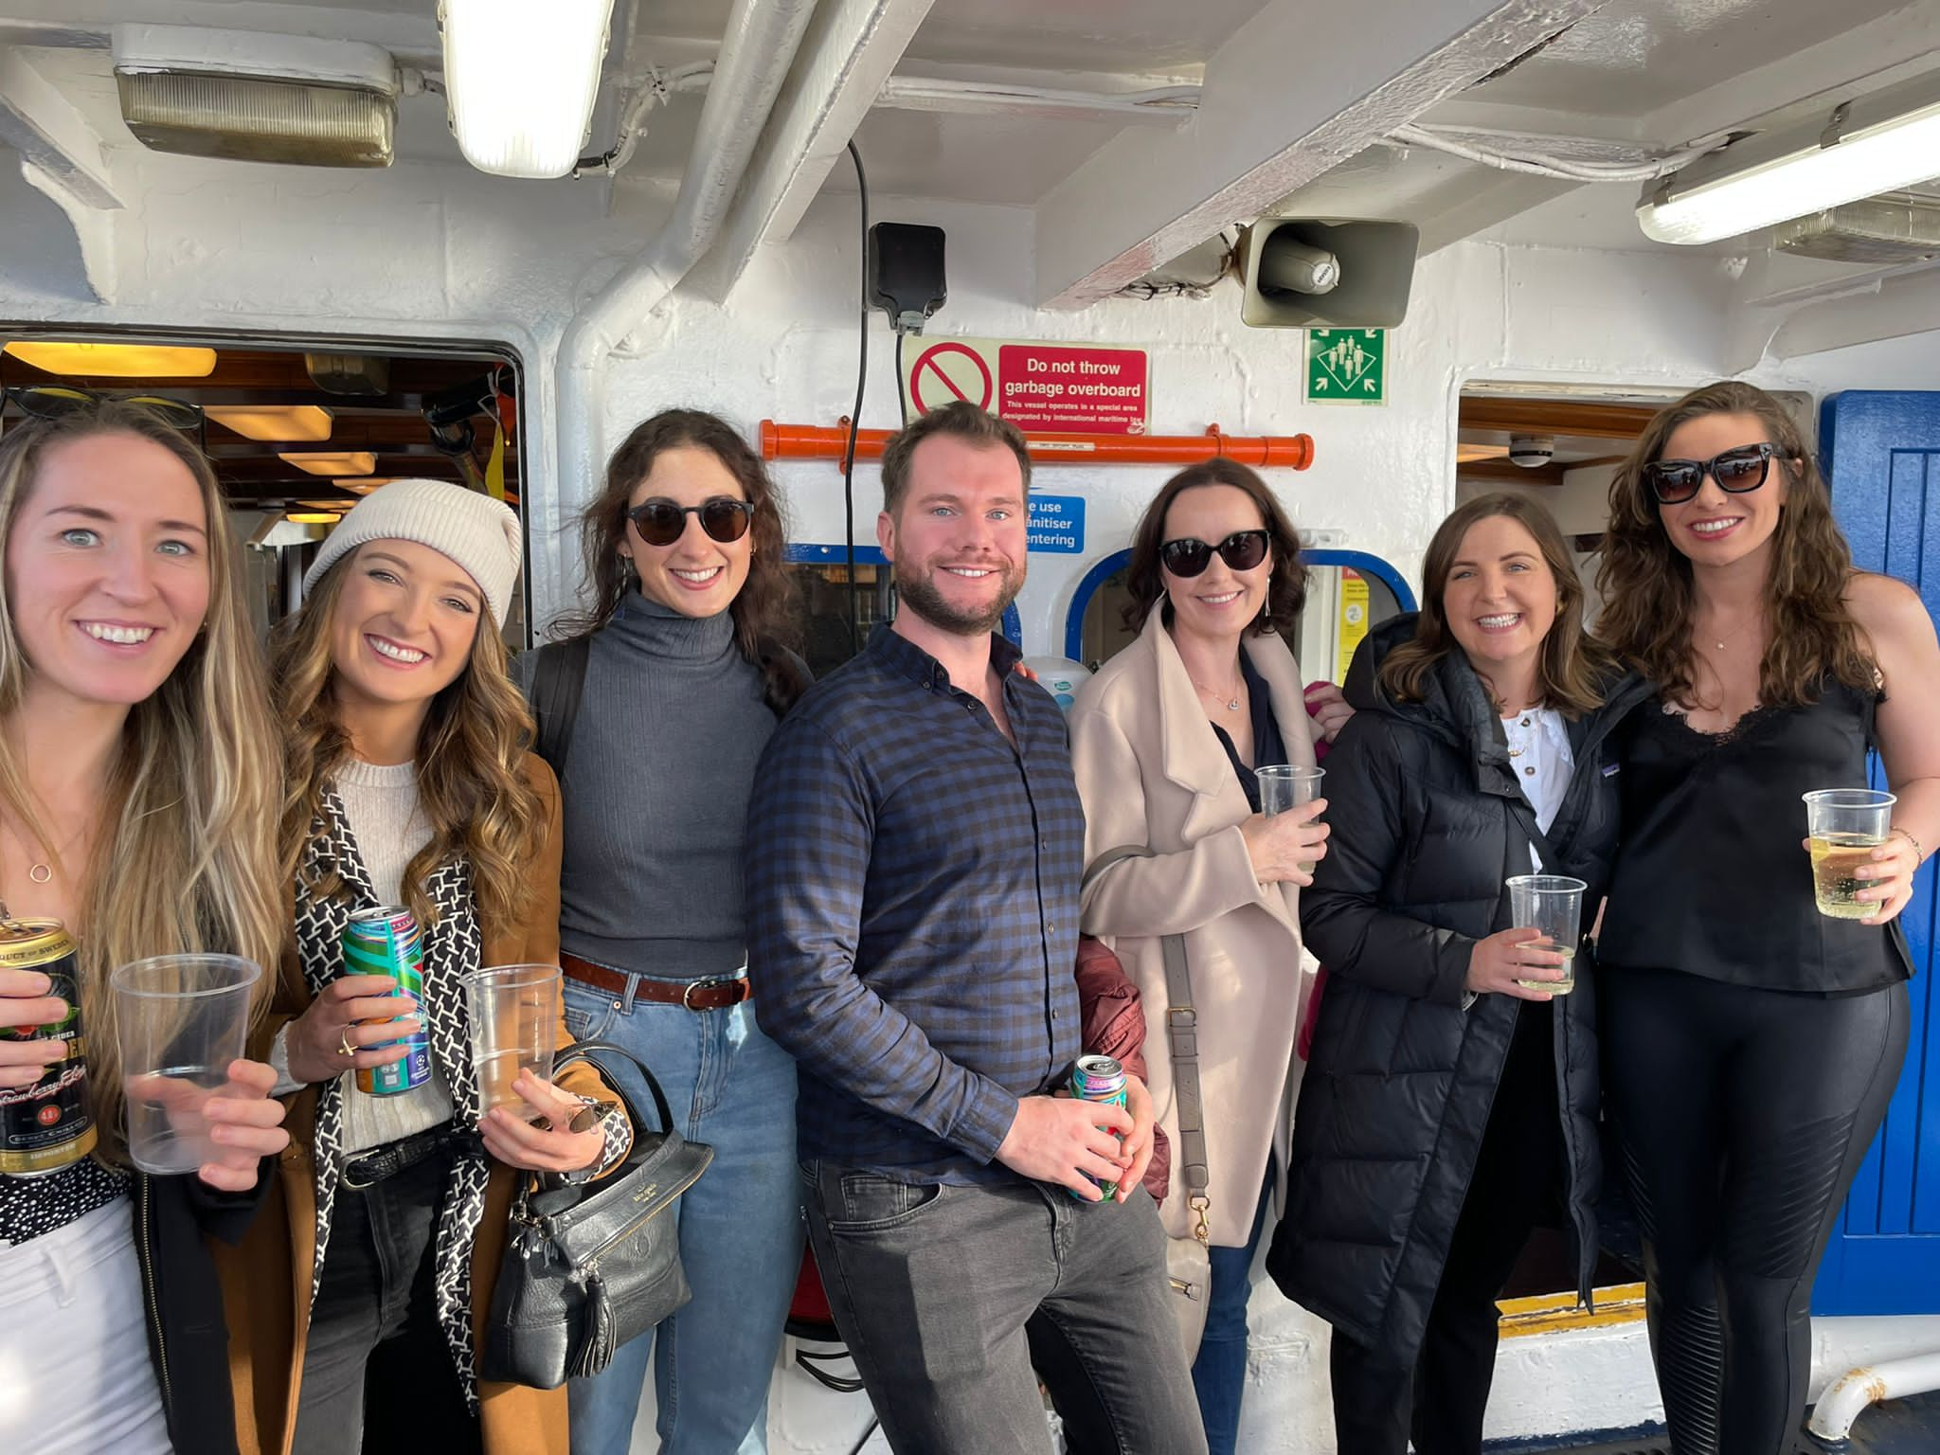
CAT Social Photos!

Slide 17
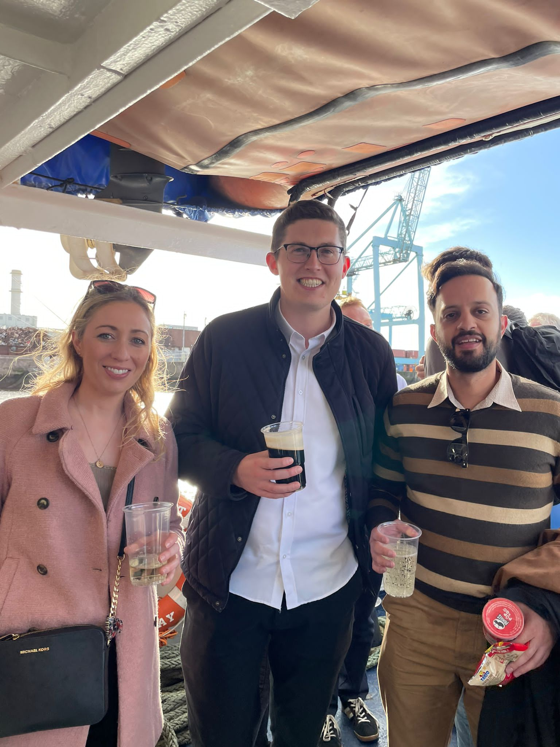
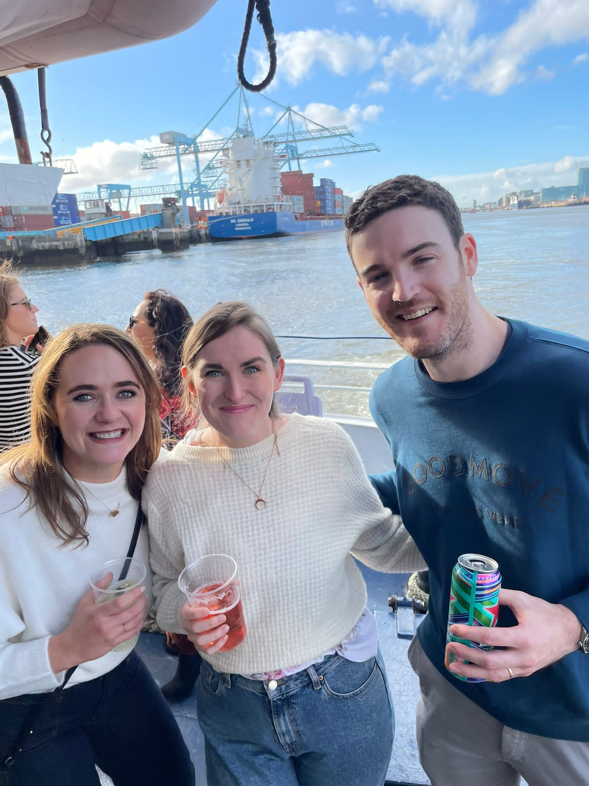
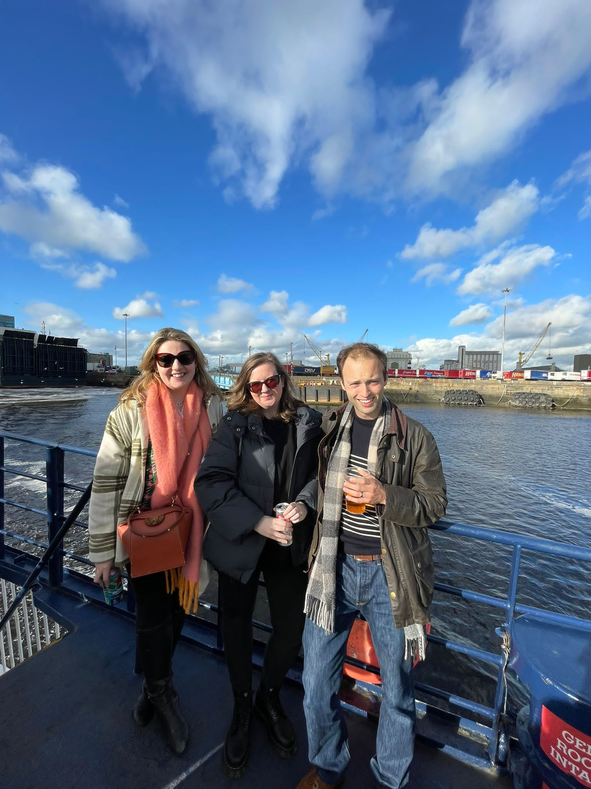

CAT Social Photos!

Slide 18
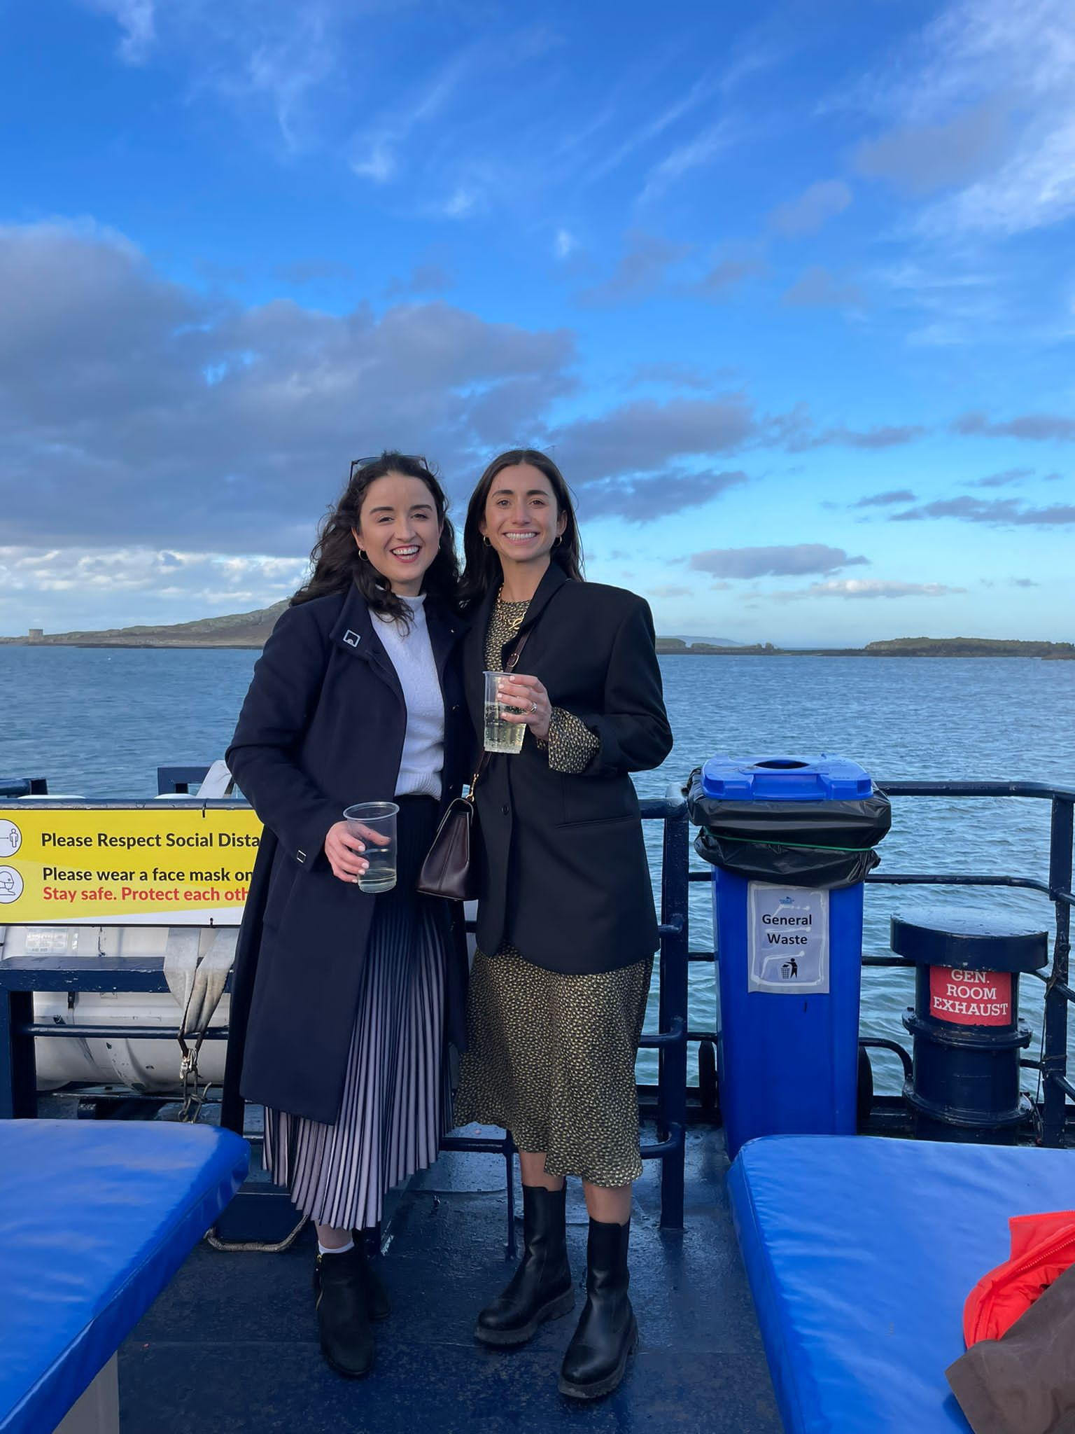
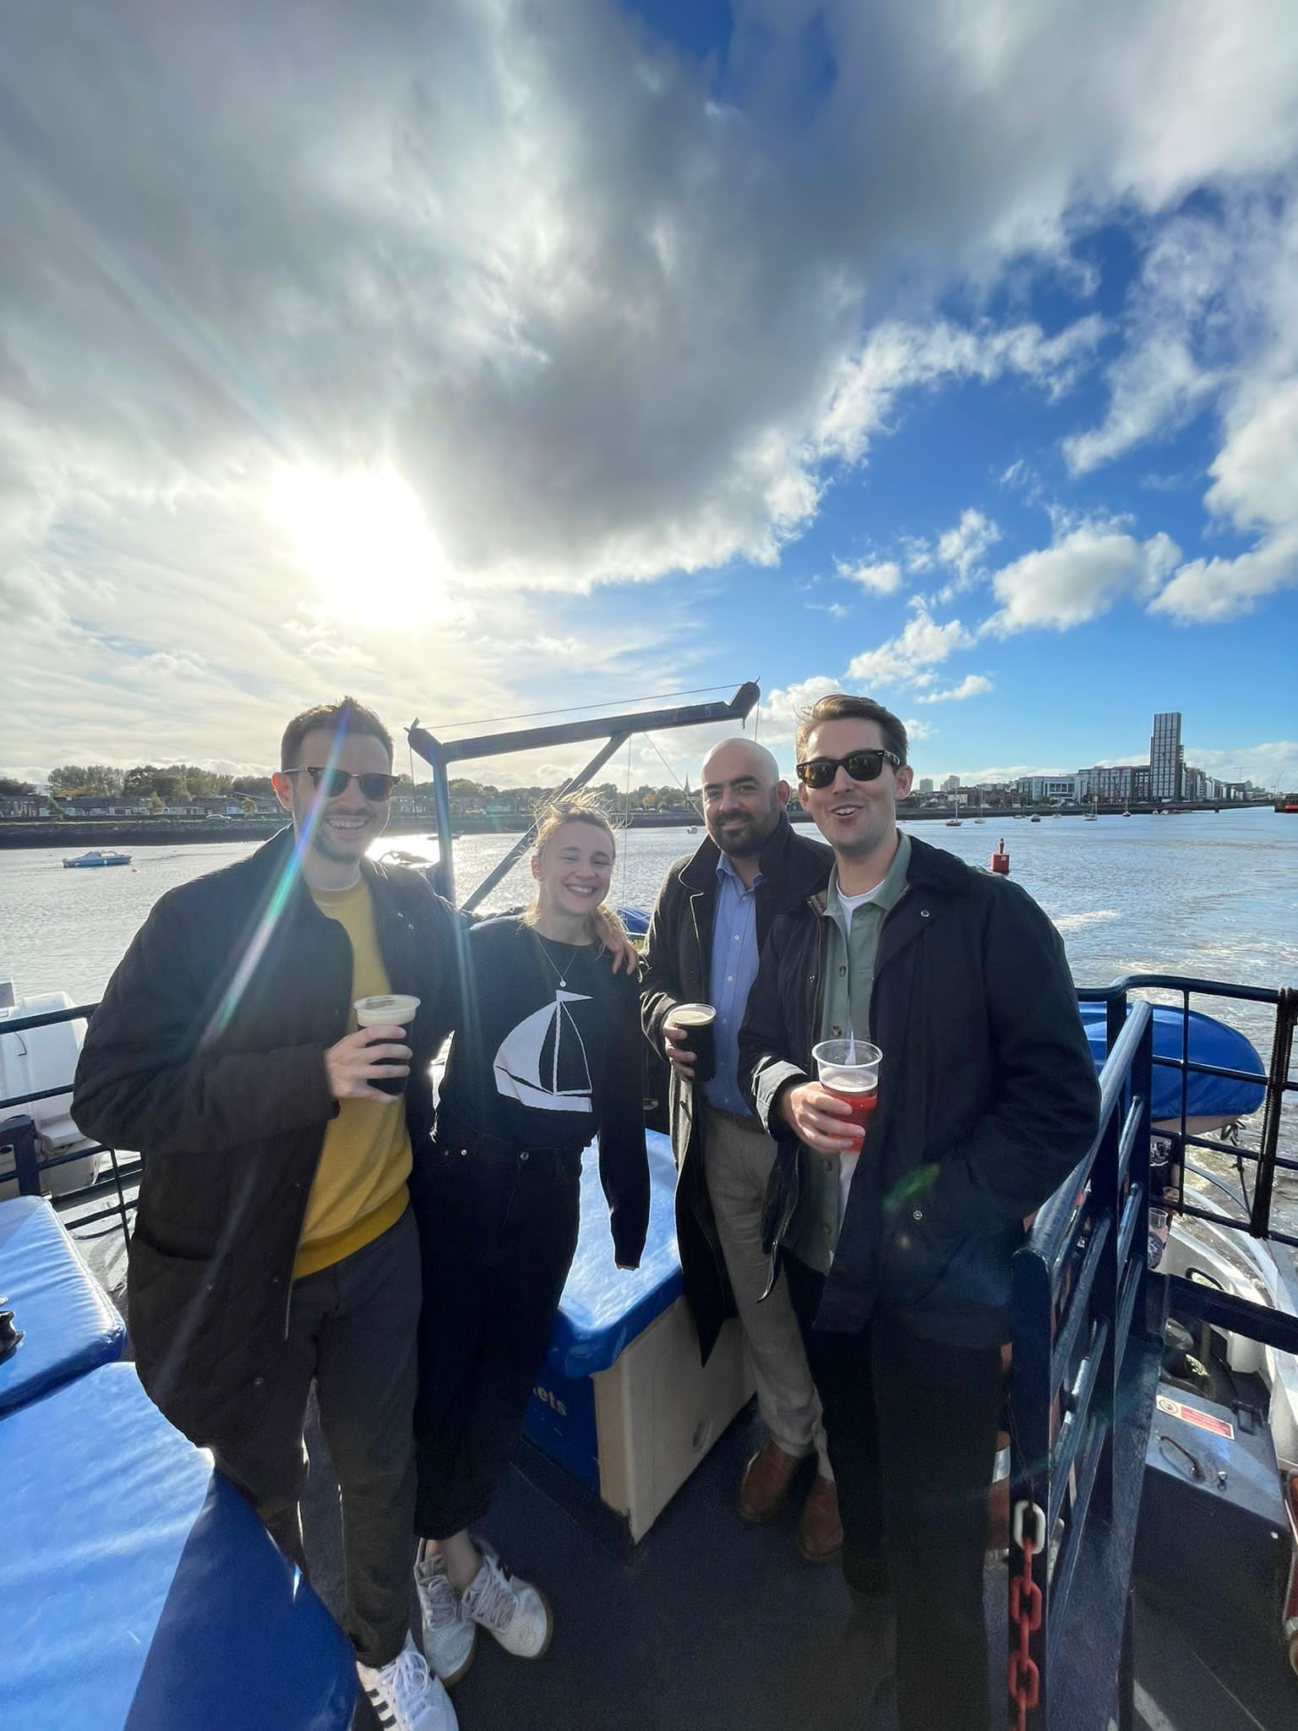
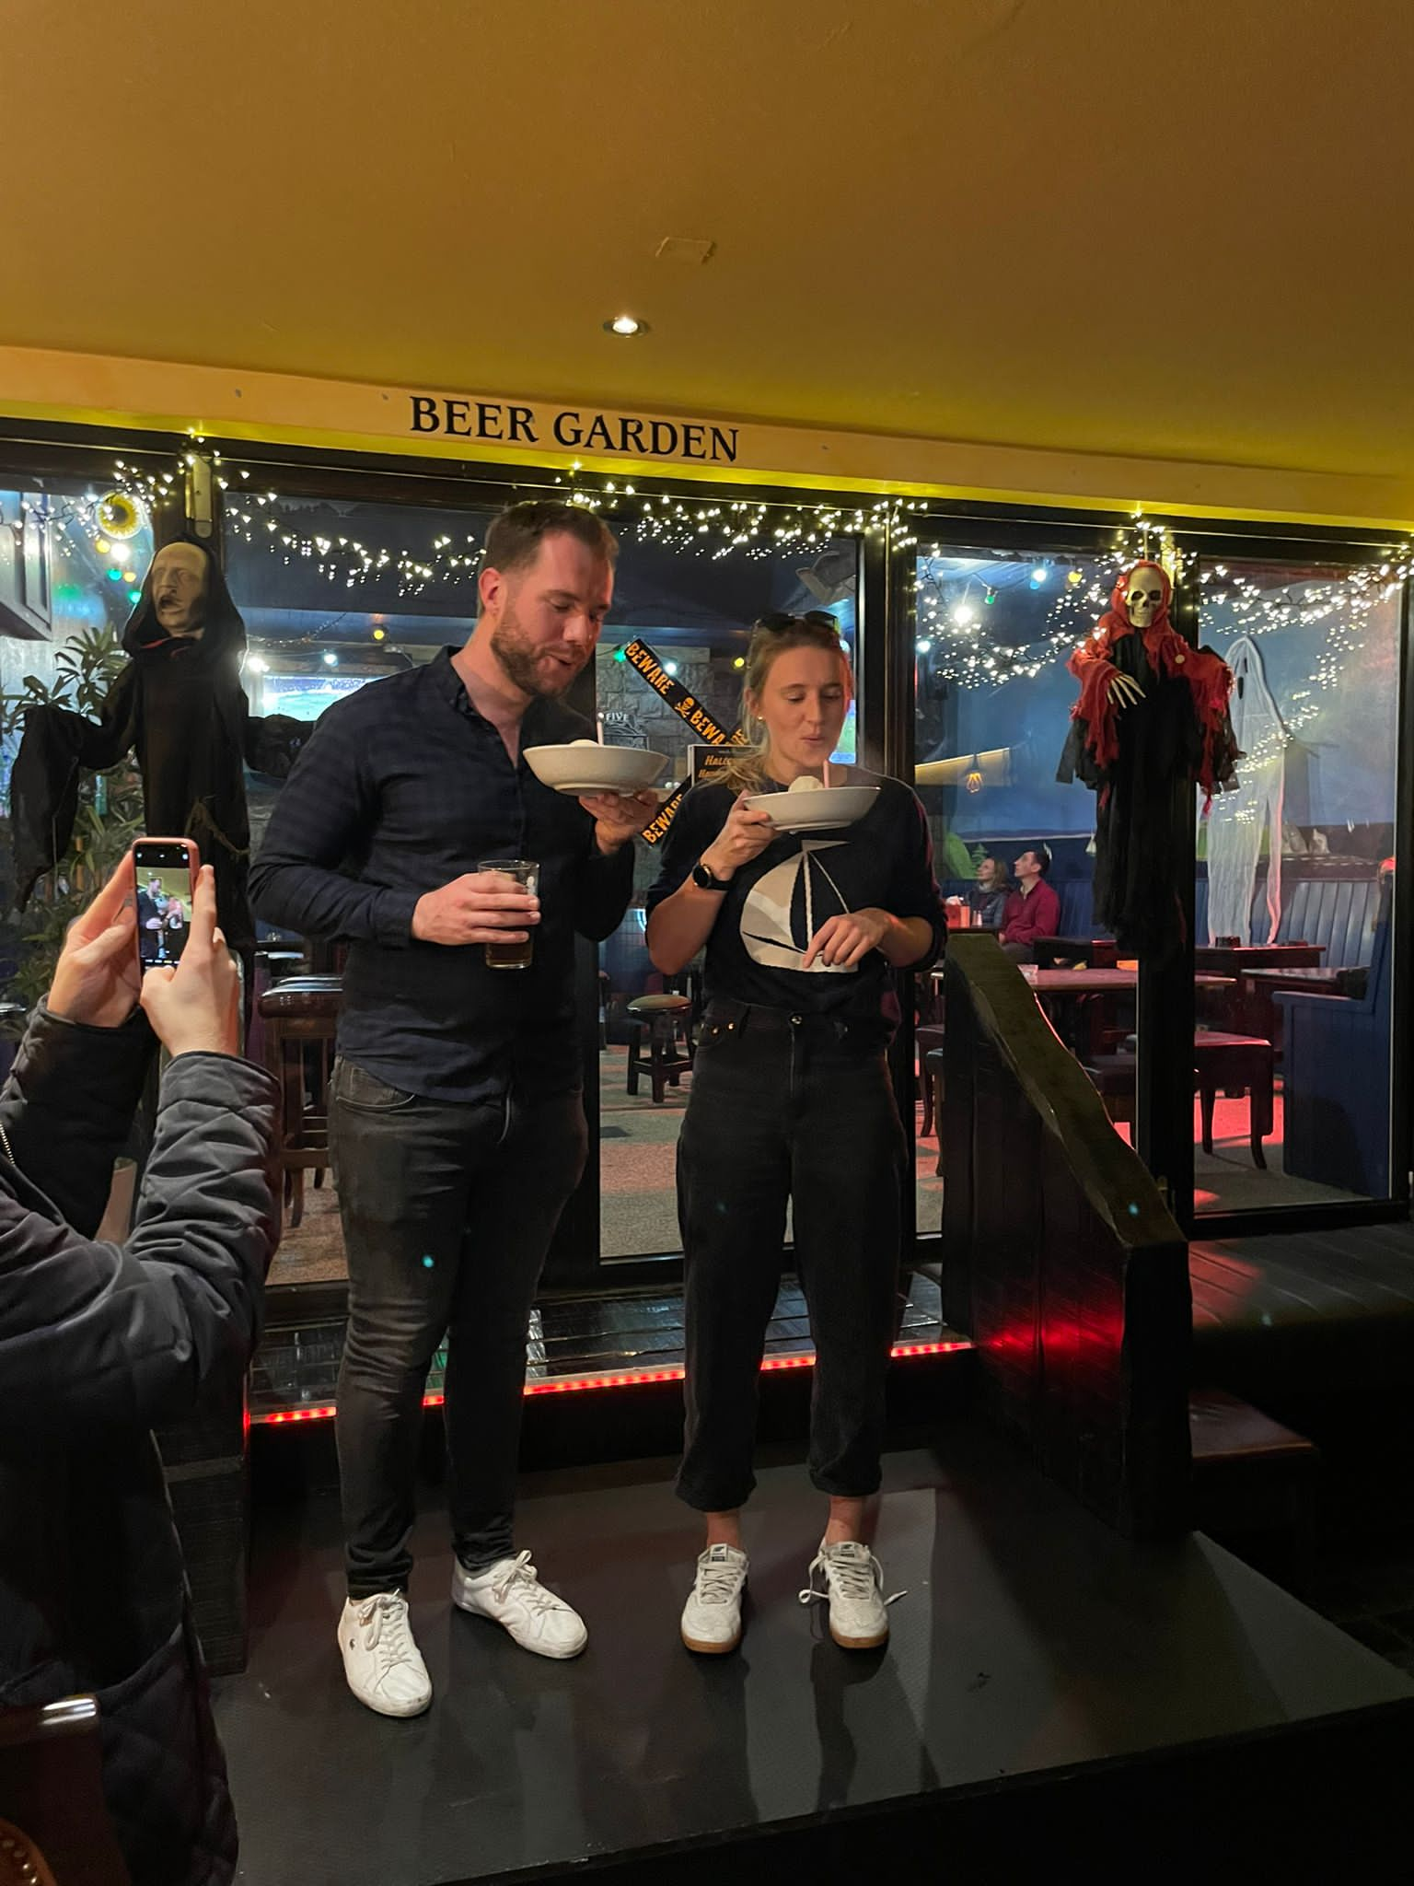

CAT Social Photos!

Slide 19
ISRA updates
Dr. Colleen Harnett
SAT 6 MMUH
ISRA wish you all a very Happy Christmas and we take this opportunity to thank you for all the support in 2022! It was a great year with lots of events and we have another busy year planned for 2023. We look forward to seeing you all again at our annual update day, foundation courses and our annual workshop at the CAI congress in May.
EDRA is always a popular exam for trainees and both part 1 and part 2 will likely take place around the ESRA 6th World Congress on Regional Anaesthesia and Pain Medicine in Paris 6th-9th September. In preparation for this, ISRA will run a prep course in early August. This course is essential for anyone sitting the exams and dates will be released soon.
As your ISRA trainee rep please contact me if you have any questions about regional anaesthesia, events we will be running or chats about regional in general.
Do follow us on Facebook www.facebook.com/israireland and twitter @ISRA_Ireland so that you don’t miss out on any event.
Lastly, be sure to sign up as an ISRA member for 2023 through the college website or at www.isra.ie . Membership not only gives you a lower fee admission for ISRA events but also automatically makes you an ESRA member so that you can view academic material and attend ESRA events as well. Looking forward to seeing you all in 2023!
Dates for your diary:
March 10th – ISRA Update Day
ISRA workshop at CAI congress
Early August – EDRA prep course

Slide 20

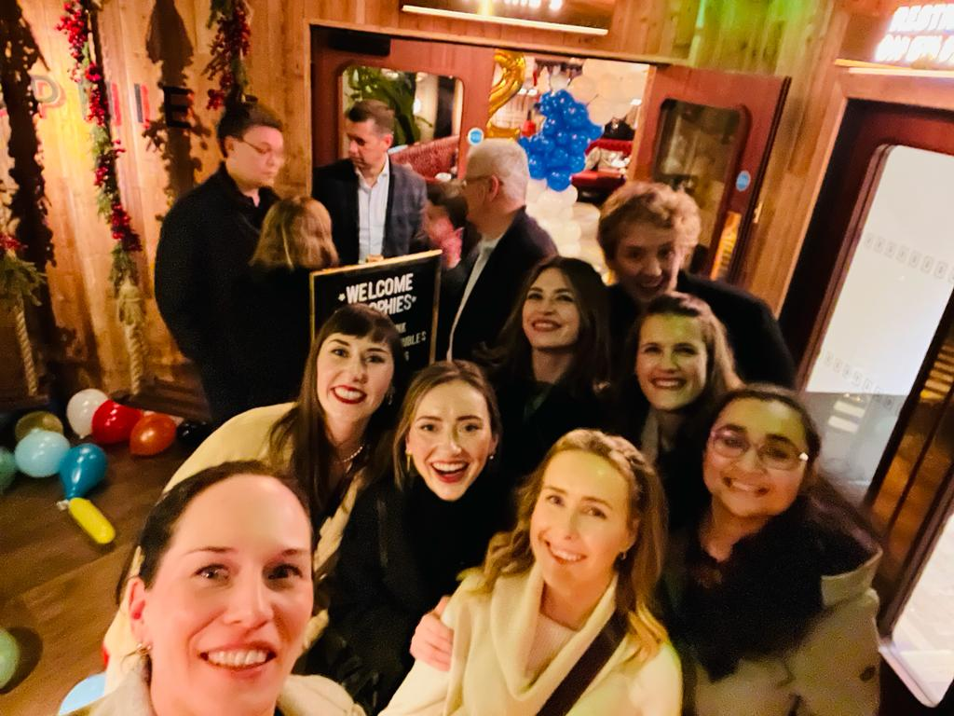
LAT News
Dr. Maeve O’Brien
LAT coordinator
Mercy University Hospital
LAT Dr. Roisin McCarthy
The Mercy Anaesthetic department has had an active social calendar recently. First there was a brilliant Anaesthetic Christmas party and more recently a department rock climbing night!
Wexford Hospital
LAT Dr.Gordian Barry
It’s been an enjoyable 6 months in the Sunny South East! After changeover, we ventured out to find the best beaches in Wexford and they did not disappoint! With Curracloe and Rosslare all a short drive from the town, we were in full sea swimmer mode by the first few weeks. As the ten-day-summer passed, the crowds flocked from the beaches to the town where a host of festivals are held in the run up to Christmas. Who knew an Internationally known Opera festival is held here every October? With the favoured Sky & the Ground (The Gingerman here in Wexford) keeping us merry and warm since the winter set in, we’ve been looking forward to the surprises this little place will bring us in the next 6 months! Maybe a beer festival if we’re lucky?
Rotunda Hospital
LAT Dr. Gerard Browne
Congratulations to Jennifer Kielty who welcomed a lovely baby boy into the world last week. We are all thrilled for her and her husband Paul.
Cork University Hospital
LAT Dr. Cian Anderson
The CUH cohort have been keeping active both in and out of the hospital over the colder months. The team proudly represented the department at the CAT Autumn Yacht Party as well as the Department’s Christmas Party at Goldberg’s, the intricate details of which will remain on a need-to-know basis! The hardiest of NCHDs also spent a brisk evening at Cork’s Run in the Dark while others were saving themselves for the Cork Jazz Festival. Joanne Fish & Dan Coffey successfully passed the MCAI Part 2 while Shane O’Keefe & Mohamad Ahmed came through the FCAI Clinical/SOE Exams unscathed. On one particularly great day in CUH, Andrew Maye celebrated his birthday while Clare Keaveney Jimenez brought home the KP Moore Medal. Shane O’Keefe got engaged while Sophia Angelov both got married and won the Consultant vote for the NCHD of the 6 months.

Slide 21

LAT News
Dr. Maeve O’Brien
LAT coordinator
Temple Street Hospital
LAT Dr. Ciarán Doherty
There have been a few social occasions this rotation with the annual theatre Christmas party attended by the most sparkling and sociable trainees. Alain Fennessy also organised a Christmas breakfast where trainees brought food and snacks to say thank you to theatre staff. As NCHD lead Marike Rademan has been hard at work advocating on our behalf at hospital meetings. Good news on the exam front as Sean Hartigan, Madhu Gnanamoorthy and Emma Garry have all been successful in passing their fellowship exams! Elsewhere, the Intensive care department has been approved for JFICMI training so trainees will now be signed off for their ICU modular time here. Finally, hospital stamped fleeces for all NCHDs are coming soon™.
Coombe Hospital
LAT Dr. Caroline Jennings
Congratulations to Fatima for passing part one for the MCAI. Congratulations to Shane P and Lydia on their fellowships. Brilliant Christmas party was had last week despite the big freeze.
Sligo University Hospital
LAT Dr. Jonathan Doran
Congratulations for Dr. Hasan Huzu on his recent marriage and Dr. Eoin O’Connor on passing the MCAI!
Connolly Hospital Blanchardstown
LAT Dr. Siobhan Clarke
The lead up to Christmas brought a paradoxical slow down in theatre as there was some serious and long overdue renovation work taking place. That didn’t slow down the enthusiasm for Anaesthesia and intensive care medicine which remained alive and well in the department!!!!
Siobhán returned from her teaching week in Kenya and presented her experiences during teaching one morning over breakfast.
The Christmas party, we’ve been reliably informed, is scheduled for December 30th.

Slide 22
e-LA- Royal College of Anaesthetists
Dr. Siobhán Clarke
SAT 3 Connolly Hospital Blanchardstown
Irish Anaesthesiology trainees are fortunate to have access to e-learning anaesthesia, a joint initiative undertaken by the Royal College of Anaesthetists and e-Learning for Healthcare, intended primarily to provide access to the knowledge base required to support specialist training in Anaesthesia.
Written and edited by anaesthetists, e-LA covers the knowledge and key concepts that underpin the anaesthetic curriculum. The learning material is presented as a structured series of bite-sized sessions including access to an extensive e-Library of articles and interactive MCQs to support continued professional development in anaesthesia.
There are 14 modules altogether covering all aspects of anaesthesia which are accompanied by a number of revision guides in areas such as pharmacology, physiology and physics.
It’s a fantastic resource for anyone sitting exams or those looking to further develop or expand their knowledge of anaesthesia. As someone who’s personally used the resource to study for the MCAI, I couldn’t recommend it highly enough!
Trainees should have received a sign- up email on joining the scheme but can always email the Training Department to request a new link if in doubt.
training@coa.ie

Slide 23
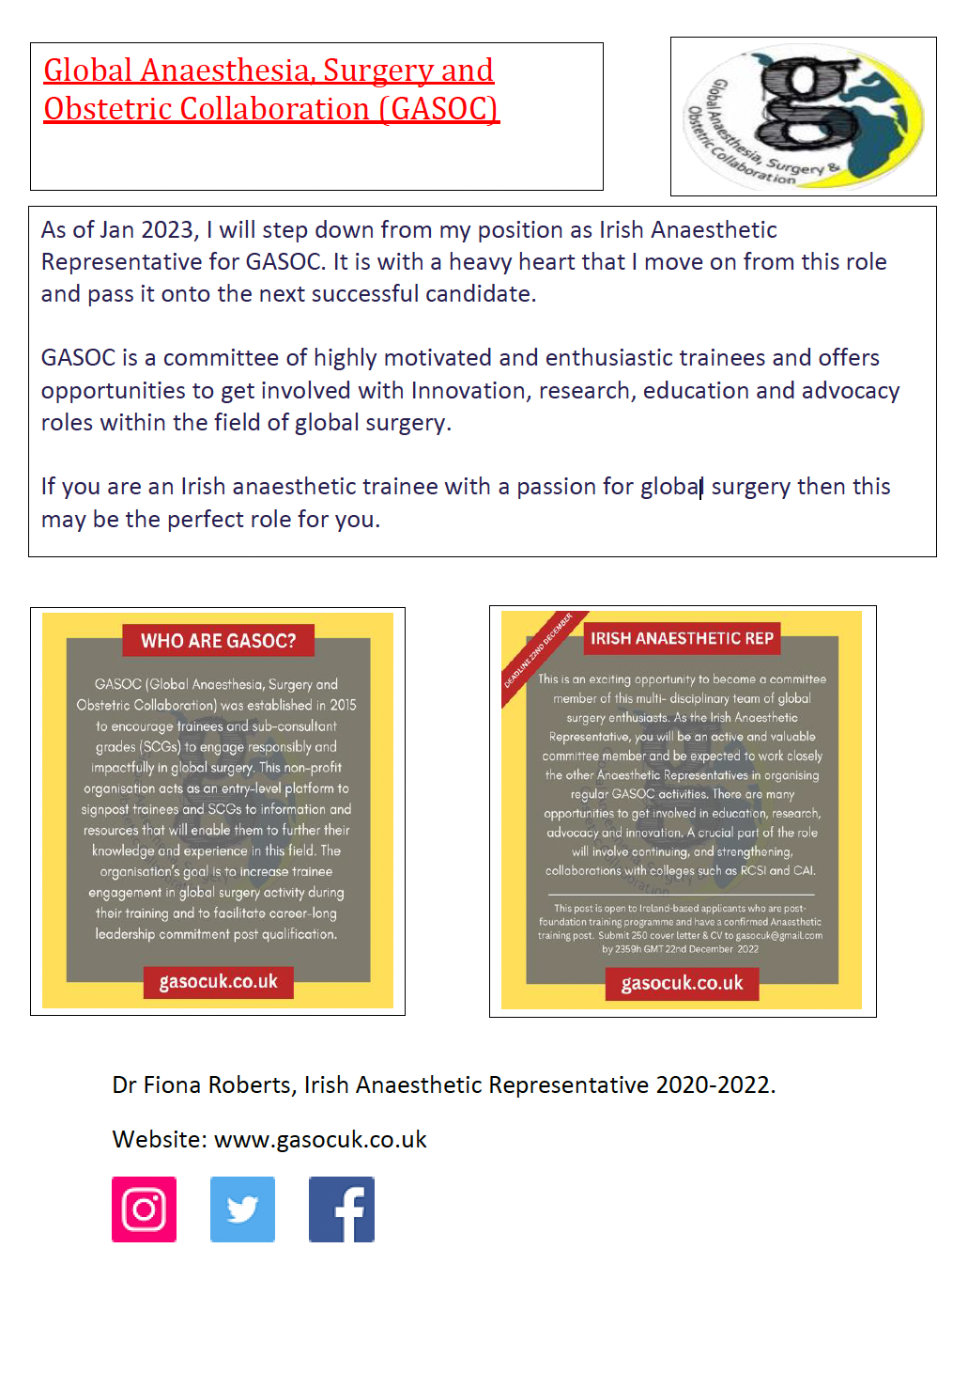

Slide 24



Support Services
Despite our best efforts, our job can be stressful. With the pandemic hopefully disappearing off into the distance, we need to remember that we still need to look out for ourselves, look out for each other and reach out to fellow trainees if you think they might be having a bad day / week / month!
Below are some resources that you may find helpful.
General Practitioner
With moving around every year or indeed every 6 months, it can be difficult to find the time to register with a GP. The National GP Directory, compiled by the ICGP, lists GPs who have indicated that they have capacity to register NCHDs, trainees and interns seeking a GP within their locality during their clinical rotations. You can access the map and directory here.
https://www.icgp.ie/go/in_the_practice/doctors_health/national_gp_directory_for_nchds
Practitioner Health
This programme provides appropriate care and support for health professionals in Ireland who may have mental health issues such as stress, anxiety, or burnout or who may have a substance misuse problem. It is fully independent and separate from the regulatory bodies and employers. It has been endorsed by Memorandum of Understanding by the relevant professional councils and is supported by representative organisations and training bodies.
https://practitionerhealth.ie/
confidential@practitionerhealth.ie
085 7601274
Pieta House
Pieta provide free counselling to those with suicidal ideation, those engaging in self-harm, and those bereaved by suicide. Staff are fully qualified and provide a professional one-to-one therapeutic service.
www.pieta.ie
24hr Crisis Helpline on Free phone 1800 247 247, or Text HELP to 51444
Therapy Services team on 0818 111 126

Slide 25


Samaritans
Samaritans is a charity in Ireland offering emotional support 24 hours a day, 365 days a year, to anyone who is in distress, lonely, struggling to cope or feeling suicidal. Samaritans has 21 local branches across the island of Ireland (13 in RoI and 8 in NI) which are run independently by a network of volunteers. Volunteers are on duty 24 hours a day, seven days a week, on the freephone helpline number 116 123
HSE Employee Assistance Programme
The HSE Employee Assistance Programme (EAP) is a work-based support service for staff and the organisation. This is a confidential independent service. It supports employees with psychosocial issues (psychological and social factors that influence mental health). These issues may be personal or work-related, affecting your job performance or home life. The service is free and available to all HSE employees.
Call 0818 327 327 to speak to someone who can help.
Websites
HSE: https://www.hse.ie/eng/staff/workplace-health-and-wellbeing-unit/
CAI: https://www.anaesthesia.ie/training/wellbeing/
Mind the Frontline: https://www.mindthefrontline.com/
UK ICU Society:
https://www.ics.ac.uk/Society/Wellbeing/Society/Wellbeing_hub/Wellbeing_Hub.aspx?hkey=c4cc359f-caac-4198-b1f2-dabac29af11a
Apps
Insighttimer: meditation app where much of the content is free with an endless supply of new content frequently being added. Users can browse between a range of popular wellbeing topics.
Headspace: An app that makes meditation and mindfulness simple
Calm: Focuses around meditation relaxation and sleep, with sessions anywhere between 3-25minutes to suit your schedule.

Slide 26
Dates for your Diary
Anaesthetic updates
February 8th-10th, Royal College of Anaesthetists London
March 28th-29th, Online
https://www.rcoa.ac.uk/events/anaesthetic-updates-0
Irish Paediatric Anaesthesia and Critical Care Society Annual Scientific Meeting (IPACCS ASM)
March 3rd-4th 2023, Kinnitty Castle Co. Offaly
Their first meeting since 2019 this meeting is set to be their best yet with international and homegrown speakers on the agenda.
https://checkout.eventcreate.com/e/ipaccs
ISRA update day
March 10th
CAT consultant interview prep course and careers evening
April 20th 2023
The Consultant Interview & CV Prep course will run in person during the day, with spaces generally reserved for senior trainees. The Careers Evening will follow on from this and starts after working hours, allowing more trainees to attend, trainees of all levels are welcome.
European Diploma in Intensive Care Medicine (EDIC)
Part I April 4th 2023
Part II May 23rd-24th 2023
https://www.esicm.org/education/edic2-2/

Slide 27
Dates for your Diary
Annual Congress of Anaesthesiology TBC
ISRA workshop
Emerging leaders conference
May 2nd– 4th 2023, Voco Kirkton Park, Hunter Valley, New South Wales, Australia
The College of Anaesthesiologists of Ireland has supported one Fellow to attend the conference..
https://www.anzca.edu.au/fellowship/information-and-opportunities-for-new-fellows/emerging-leaders-conference
Anaesthesia 2023
May 16th-18th, Birmingham
https://www.rcoa.ac.uk/events/anaesthesia-2023
Association of Anaesthetists
Winter Scientific meeting Jan 12th-13th 2023, London
Trainee Conference July 6th-7th 2023, Leeds
Annual Congress September 13th-15th Edinburgh
Critical Care reviews 2023
June 14th-16th, Belfast
https://criticalcarereviews.com/meeting/ccr23
Euroanaesthesia 2023
European Society of Anaesthesiology and Intensive Care
June 3rd-5th, Glasgow, Scotland
https://euroanaesthesia.org/2023/

Slide 28
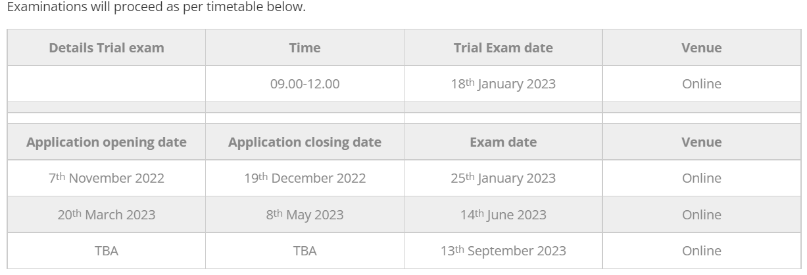
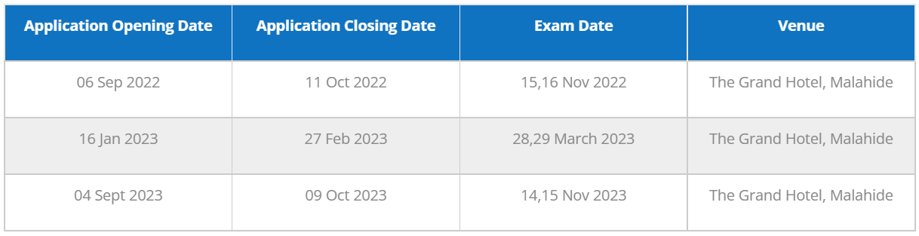
Dates for your Diary: MCAI
MCAI: MCQ
MCAI: OSCE/SOE

Slide 29
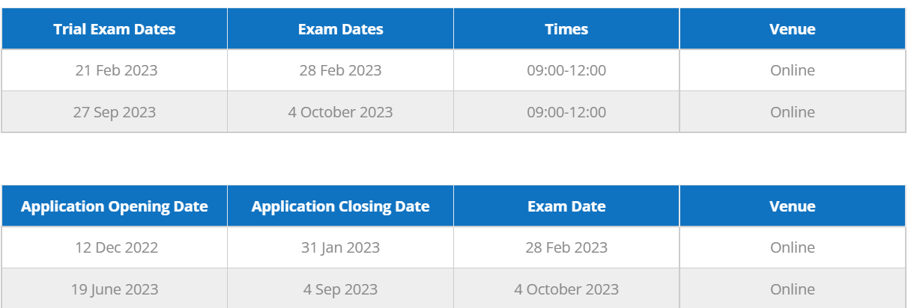
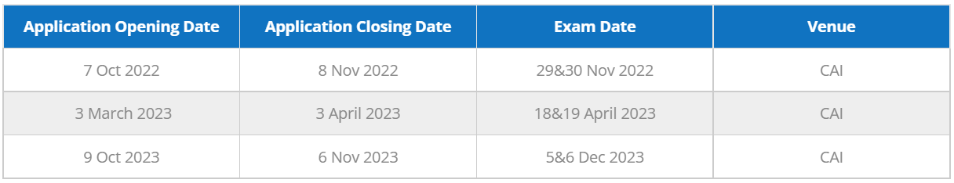
Dates for your Diary: FCAI
FCAI: Written
FCAI: Clinical/SOE

Slide 30
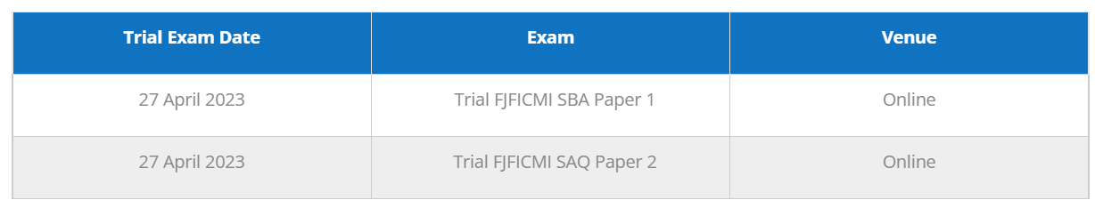
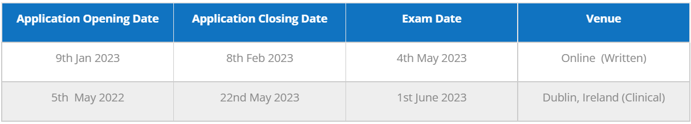
Dates for your Diary: FJFICMI
FJFICMI: Trial exam
FJFICMI: Written/Clinical

Slide 31


