Slide 1
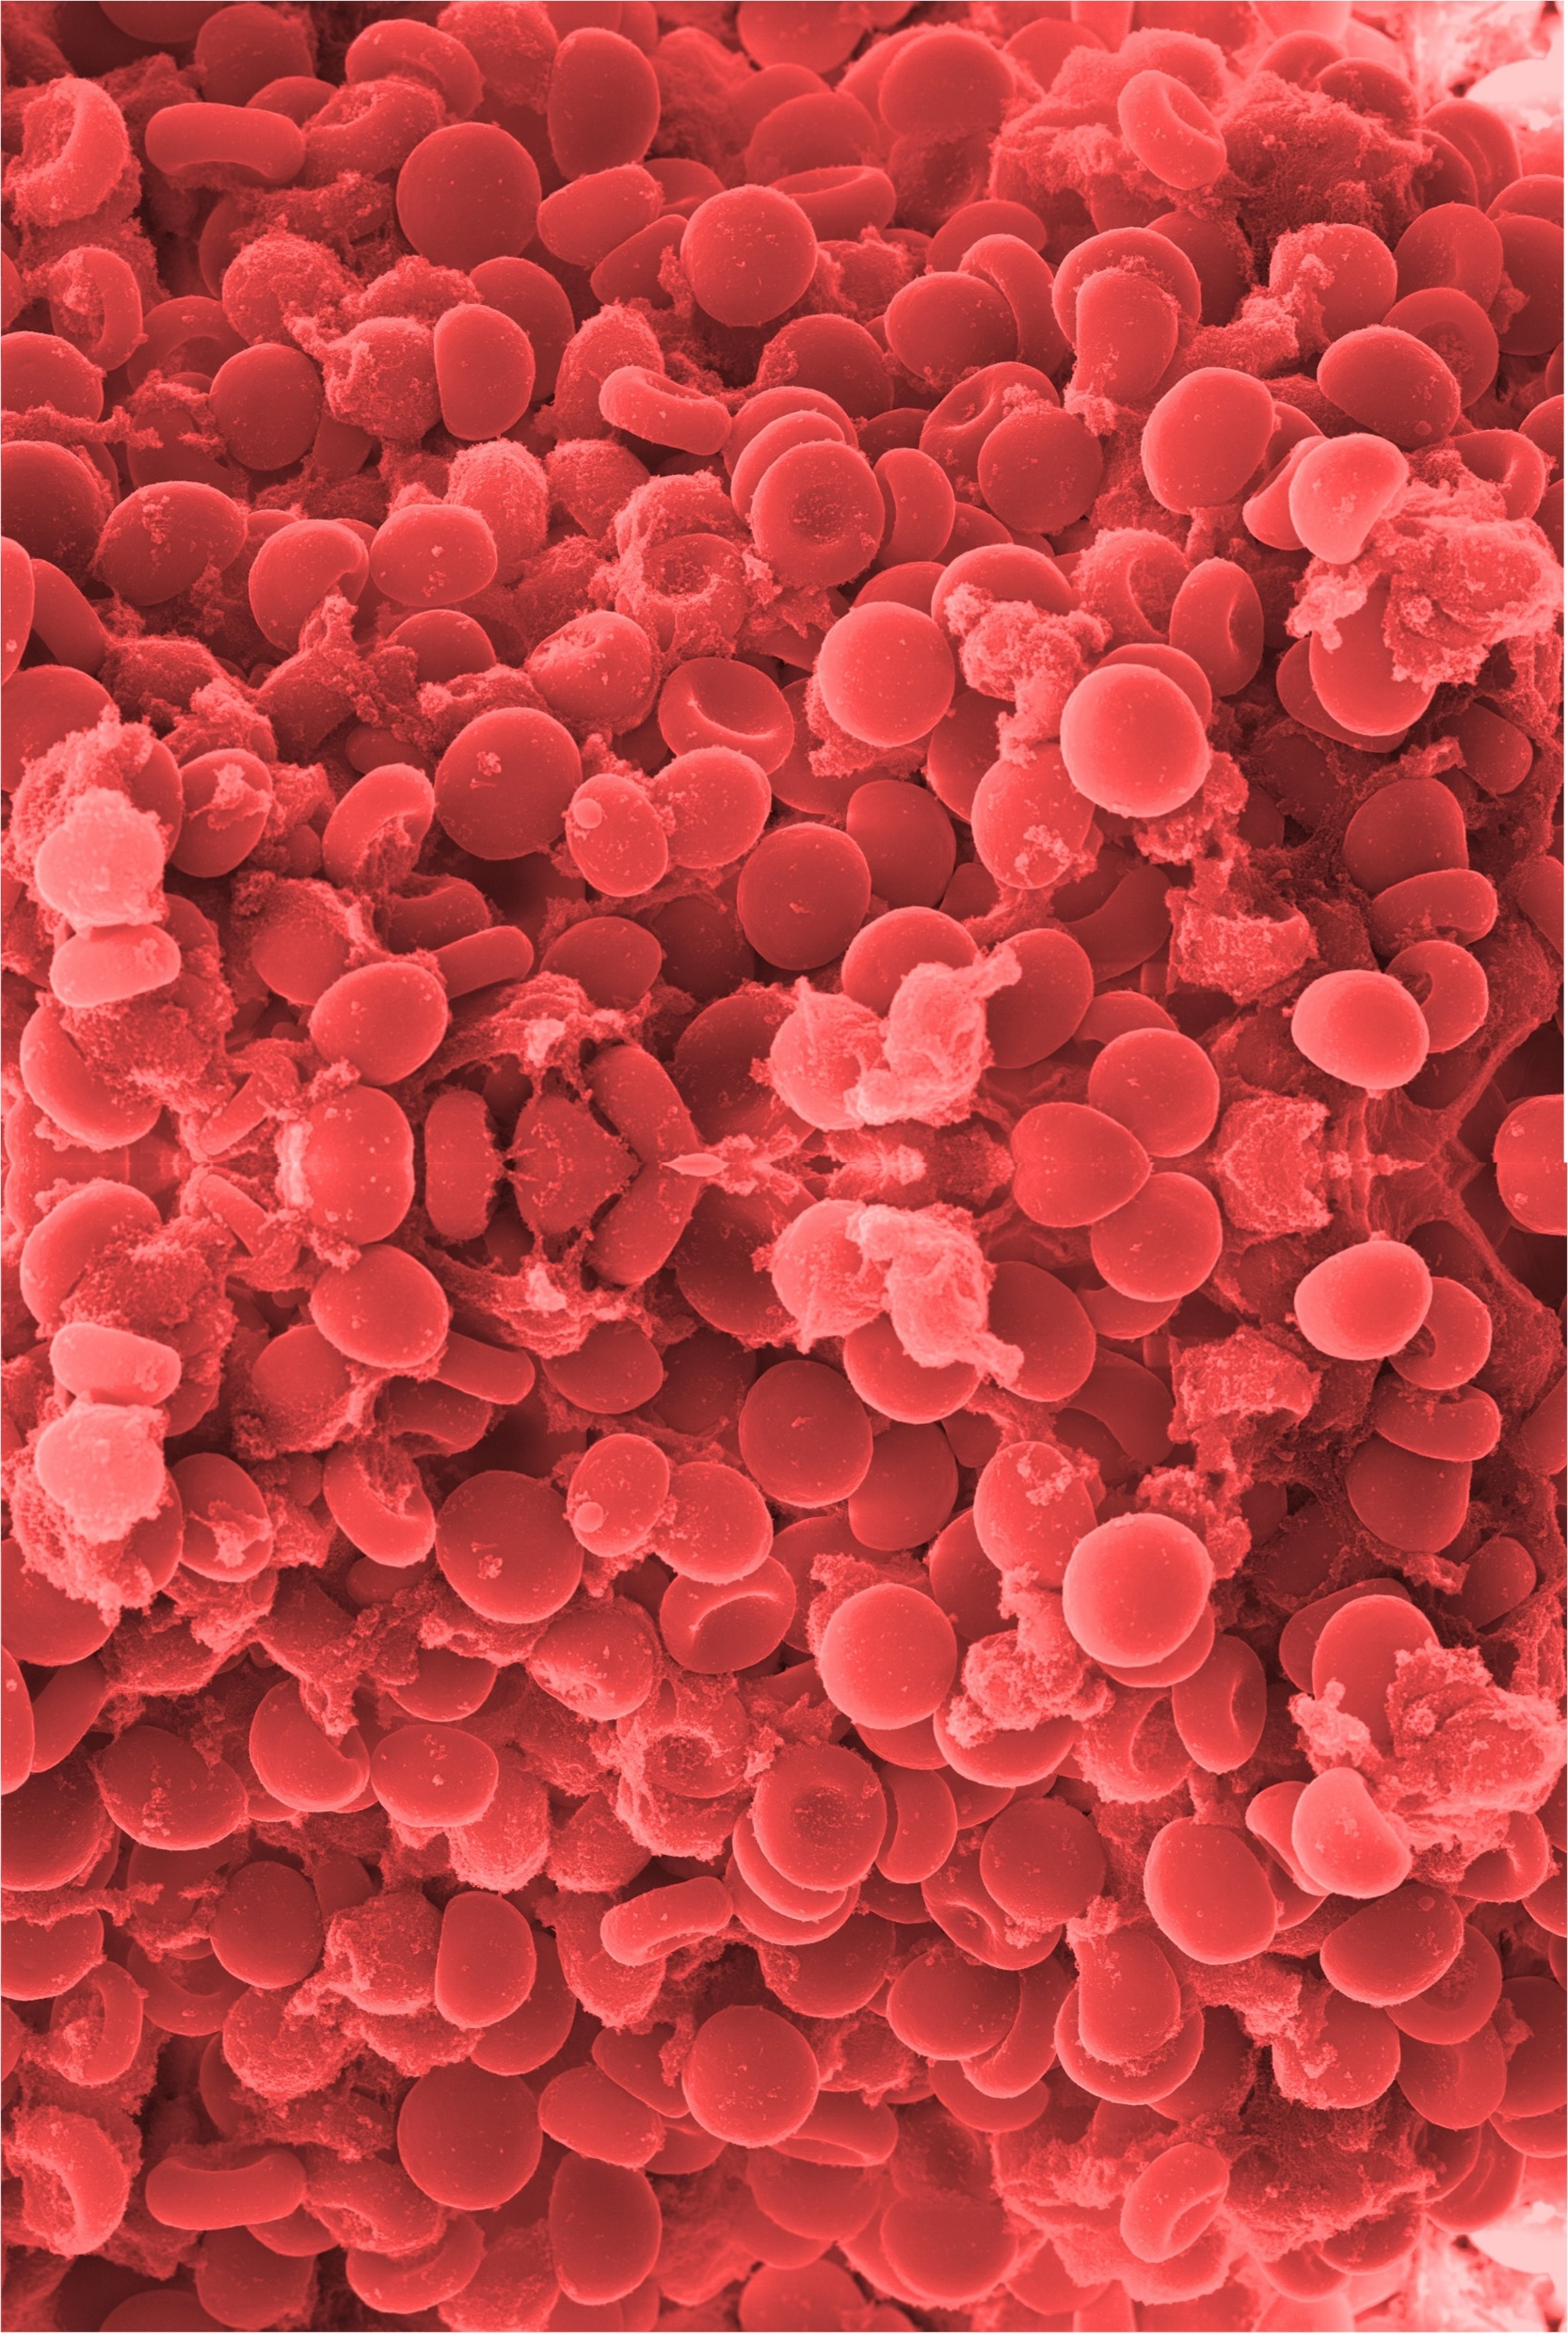

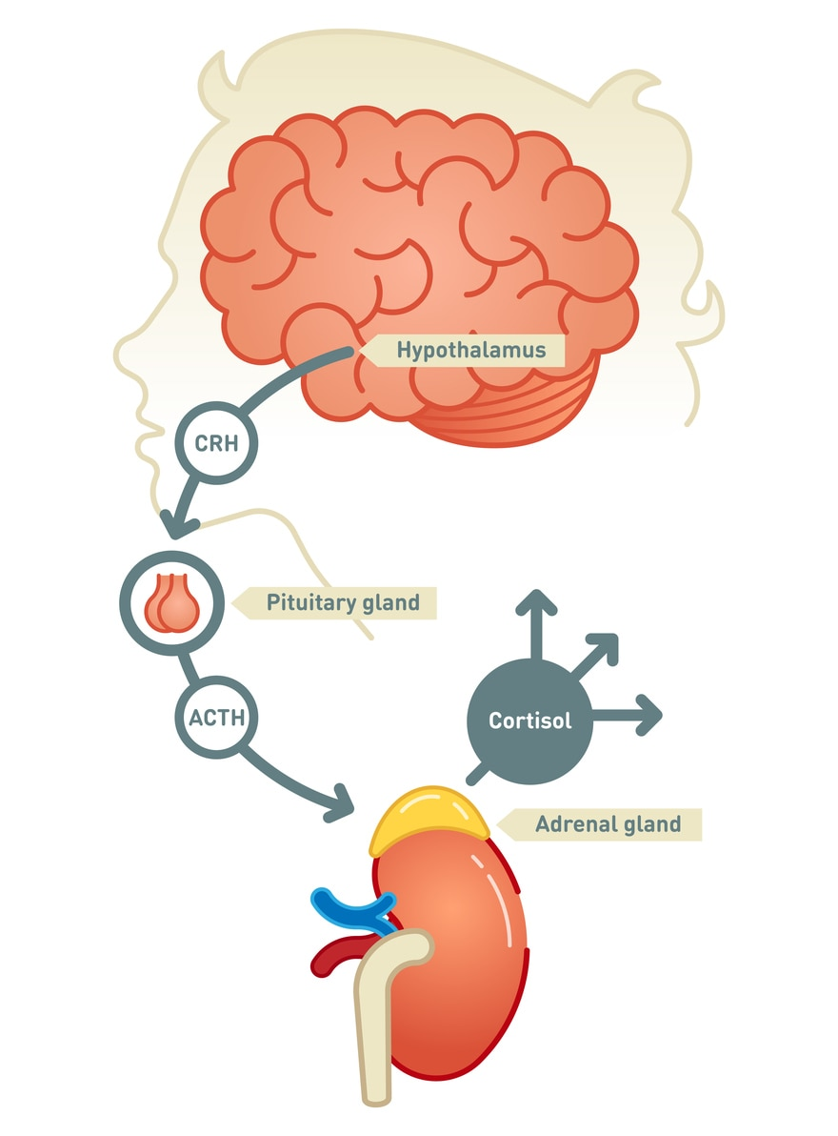
Case of Adrenal insufficiency
Authors : Dr Krishna Reddy, Dr Tommy McGimsey, Dr Muralidharan Selvanambi
Department of Anaesthesia, University Hospital Waterford, Waterford.
Introduction: Adrenal insufficiency (Addison’s Disease or Hypoadrenalism) is a rare endocrine disorder of adrenal glands. The adrenal glands is made up of the outer cortex and inner medulla. The cortex produces steroid hormones like aldosterone, cortisol and androgens, and the medulla produces the catecholamines like epinephrine, norepinephrine. Adrenal insufficiency can be primary, secondary, or tertiary. Primary adrenal insufficiency occurs as adrenal cortex gets damaged by autoimmune destruction..Secondary adrenal insufficiency occurs as pituitary gland doesn’t make enough of the hormone ACTH. Tertiary adrenal insufficiency occur when the hypothalamus doesn't make enough corticotropin-releasing hormone. Cortisol is called stress hormone helps to control blood pressure, blood Glucose, metabolism & reduce inflammation.
Labs Investigation : Blood: Na 131 mmol/L, K 4.2 mmol/L, Creat 220,eGFR 19, Urea 20.5 mmol/L, BNP 2476 pg/ml (0-125 ), INR 5.2, APTT 44 secs ( 22 -34), PT 47.7sec (8.7 –12.7).
Troponin, LFT,Platelets, WCC,CRP were normal.
No Obvoius source of infection.
Cortisol 574 , 578( Morg : 166 – 507 nmol/lit ) Afternoon ( 74 – 291). ACTH – Pending.
HbAlc 45( increased), TSH 3.9 ( 0.27 -4.2),
Free Thyroxine 22.7( increased).
Prolactin 121 miu/l, FSH 24.3 iu/l, LH 34.7 iu/l were normal parameters.
Discussion :
Hyperkalemia and non-anion gap metabolic acidosis (NAGMA) occur in primary adrenal insufficiency
This patient presented with acute symptoms consistent with Addison’s disease. Autoimmune adrenal insufficiency is generally an insidious process with zona glomerulosa and zona fasciculata effected which may cause low serum aldosterone and cortisol and increased ACTH. Positive adrenal antibodies confirms autoimmune cause.
Treatment given: Glucogel, 1mg I.M Glucagon given pre hospital. Atropine 0.5mgs-6doses( No response noted), Fluid :2lit Hartman’s , 50 %, 50 mls Dextrose- two doses. Tazocin:4.5gms, 100 mls of NaHco3 8.4%, Boluses of Ephedrine(30mgs),Adrenaline100Mcgs increments:6doses, Noradrenaline infusion 40mcg/hr.
All the above treatment did not improve the GCS, Sinus bradycardia and Hypotension .
After 1 dose of Hydrocortisone 200mg intravenously patient improved clinically. GCS 15/15,Heart rate:70 to 80/min, Blood pressure MAP >65. . Vasopressors were stopped.
Case Report : A 72 years old female presented to hospital with sudden unwitnessed collapse.
O/E: No signs of head injury.
GCS 8/15, B/L pupils dilated with sluggish response, Temp Unrecordable, Hypoglycaemia 0.2 mmol/L, Bradycardia (HR 20 -30 BPM), Hypotensive (60/40), Anuric.
Background history of:
Hypertension, Hypercholestermia, Atrial fibrillation, CCF, NIDDM, Hyperthroidism.
XR Chest and CT Abd/Pelvis showed no acute pathology
actate
(Arterial blood gas)
Conclusion:
This patient presented with signs & symptoms of acute Adrenal insufficiency and responded very well to steroid therapy.
We recommend that the clinicians to be aware of rare diseases like this case so that the diagnosis and treatment could be initiated early.
Adrenal Insufficiency
↓ Na+ ↑ K ↓ HCO3 ↑ urea ↑ creat ↓ Gluc
↓ cortisol,↑ ACTH
Hyperkalemia and non-anion gap metabolic acidosis (NAGMA) occur in primary adrenal insufficiency
References
https://www.clinicalkey.com/#!/content/playContent/1-s2.0-S2049080121006774
https://emcrit.org/ibcc/adrenal-crisis/
.https://emed.ie/Metabolic/Addisons.php
PH | HCo3 | Lac | Gluc | Na | K
7.12 | 10.4 mmol/L | 9 mmol/L | 0.2 mmol/L | 129 mmol/L | 7.9 mmol/L

