Slide 1
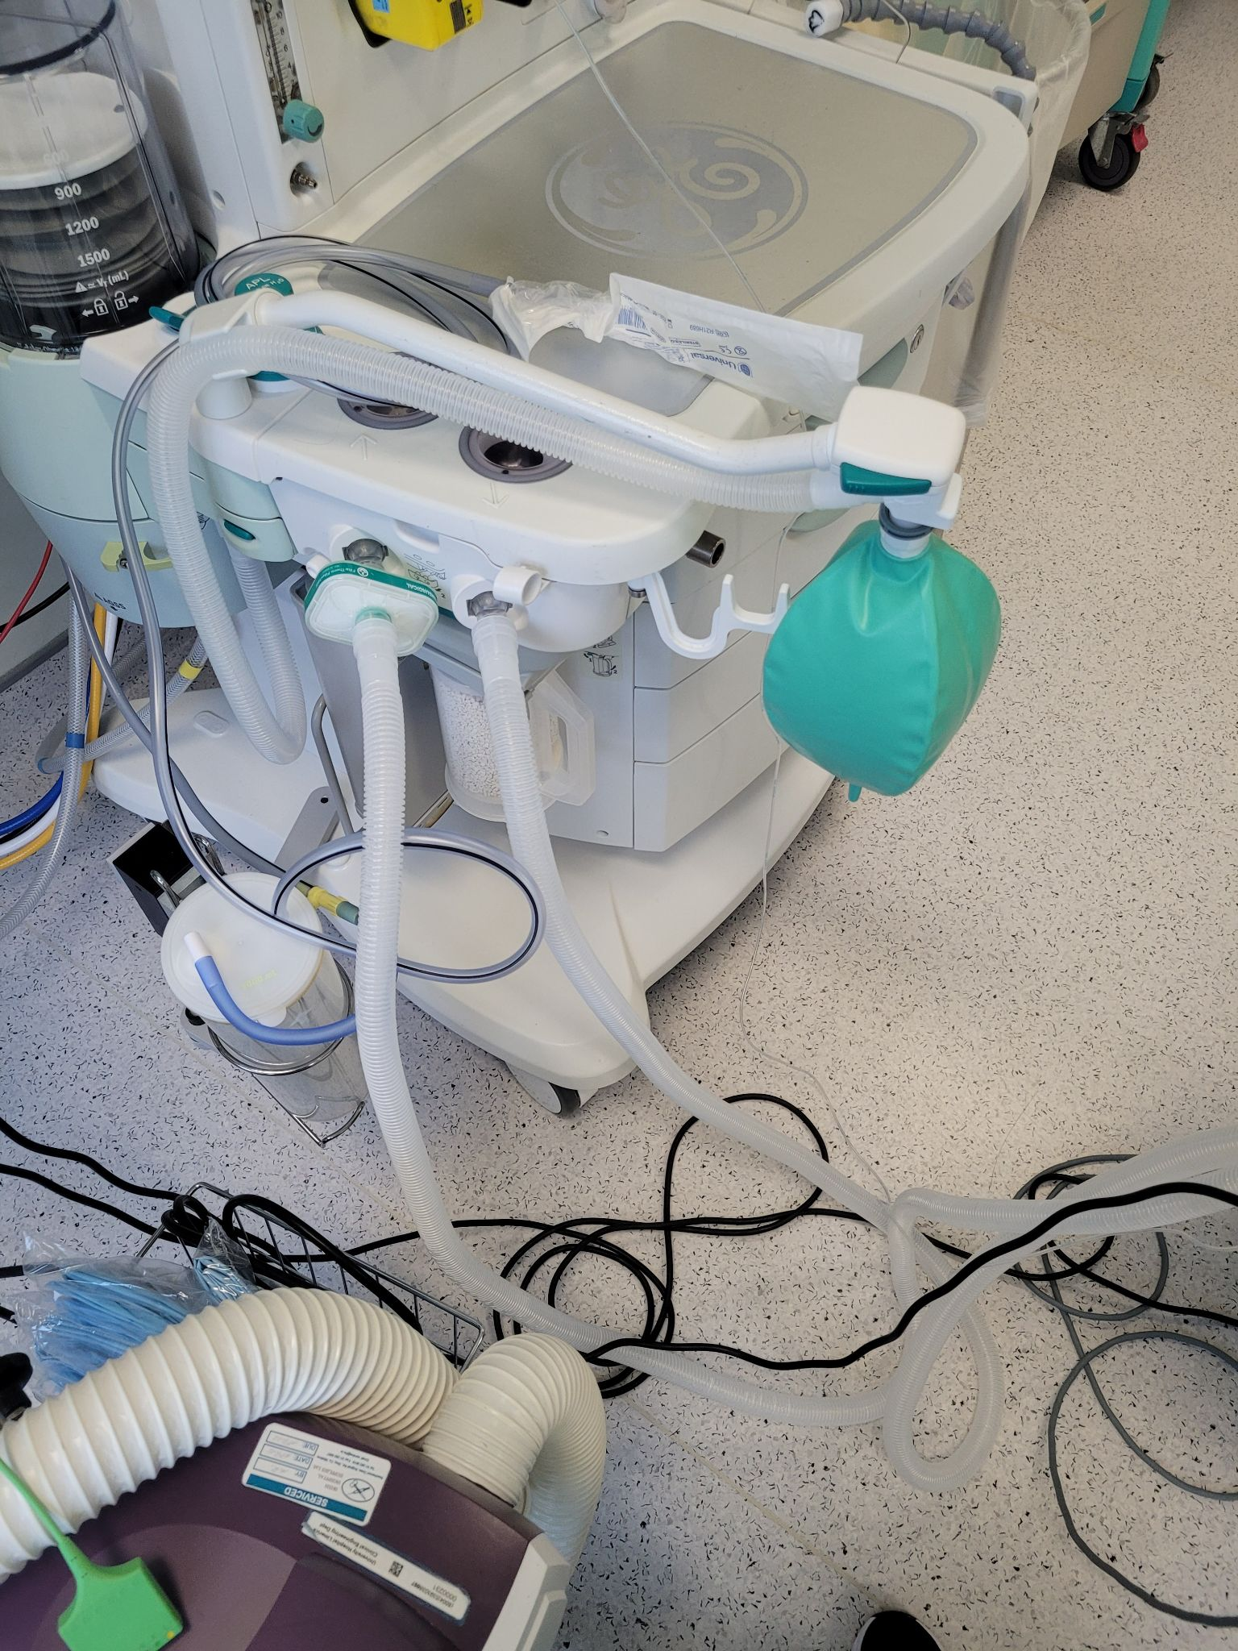
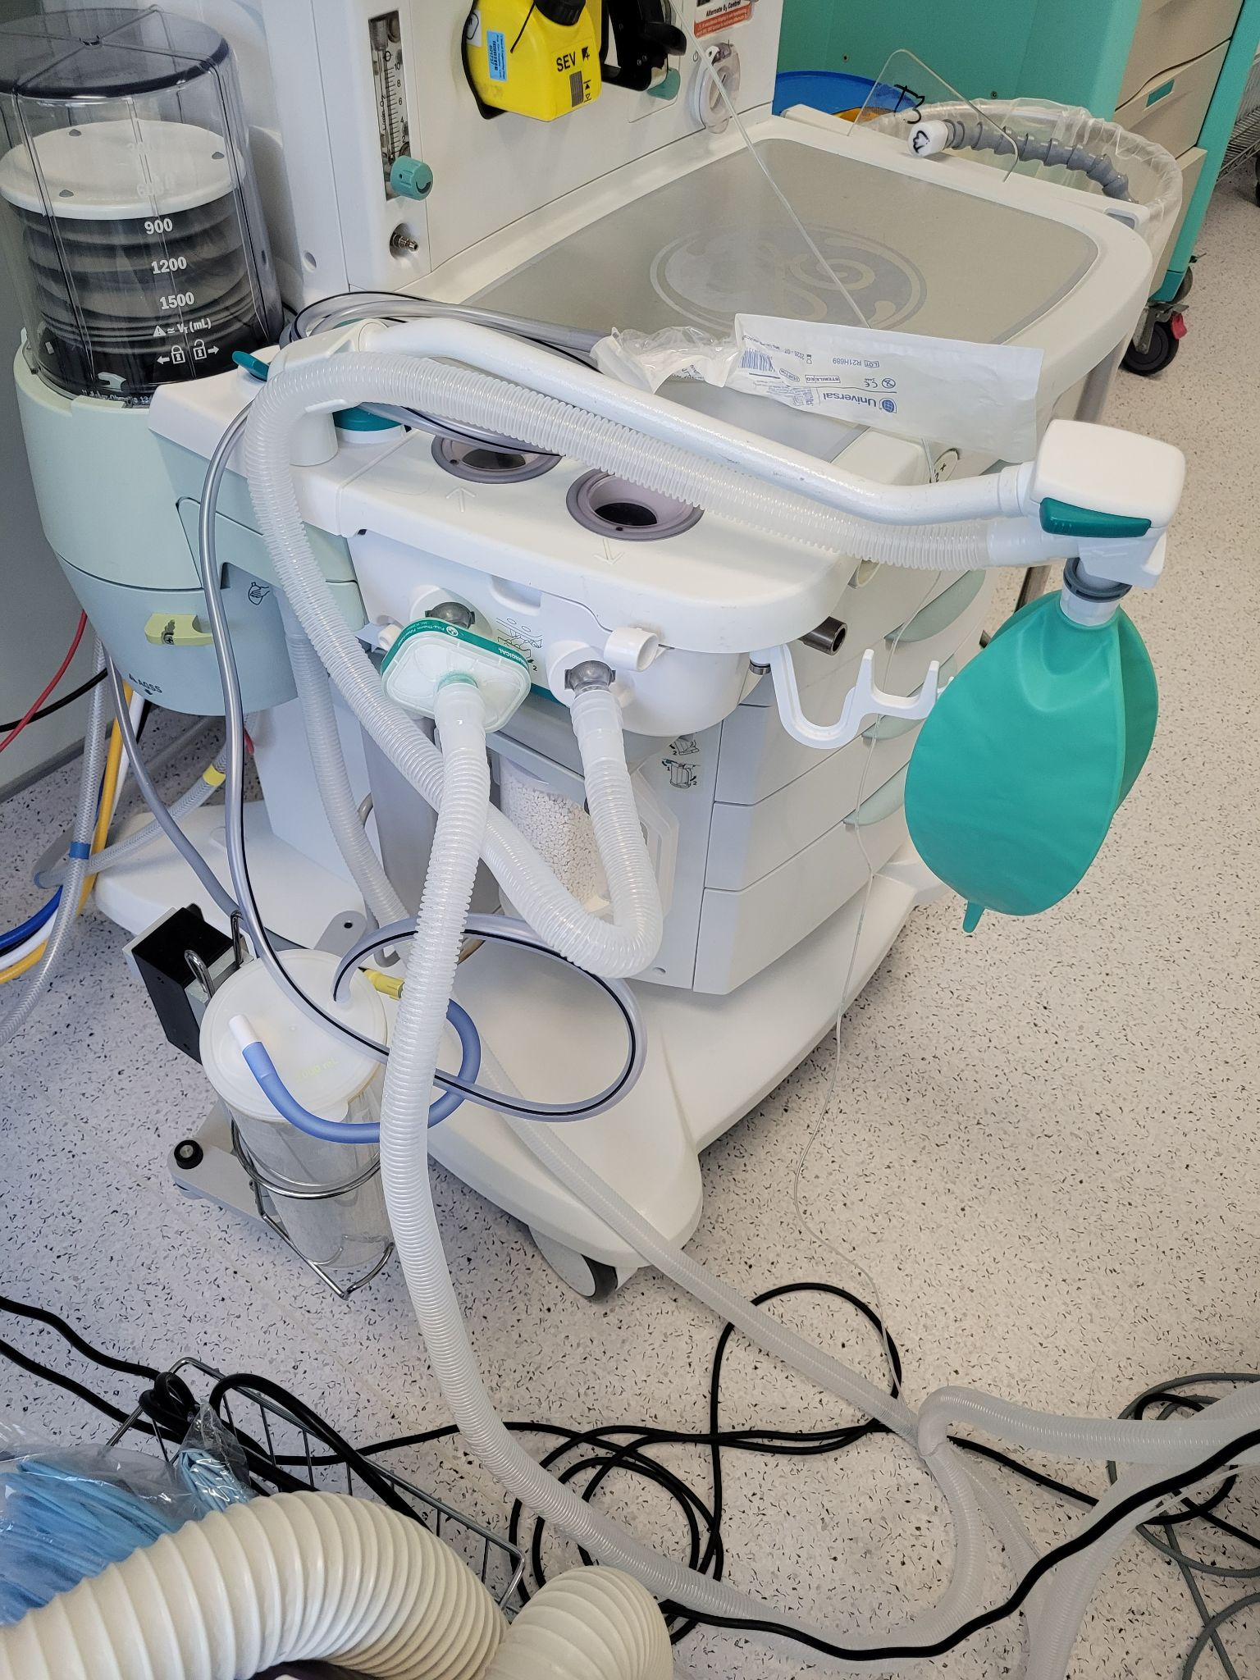
Spot The Difference: Case Presentation
Dr Naomi Quigley
University Hospital Limerick
Background
An 18 year old male with acute appendicitis presented to the emergency theatre at 2330 for a laparoscopic appendicectomy.
He had a background history of Autism Spectrum Disorder, with no other significant medical or surgical history.
We prepared the theatre with minimal staffing and dimmed the lighting to minimise sensory overload for the patient
Discussion
As you can see from these two pictures,picture B has an incorrectly formatted anaesthetic machine, the bag mask limb is connected to the inspiratory limb and this resulted in our inability to ventilate the patient
We had been using this ventilator all day and this case was at 2330. The case preceding this one had involved large blood losses that contaminated the ventilator. Between cases the attendants had cleaned the room and ventilator disconnecting and reconnecting the limbs without informing us
Conclusion
The association of anaesthetists of Great Britain and Ireland has well known guidelines regarding checking the anaesthetic machine at the start of every day. It has less well known and less well adhered to guidelines regarding machine checks between cases.
We were very fortunate in our case that we had adequately preoxygenated our patient and that they were a young fit and healthy man who had a significant respiratory reserve that he didn’t desaturate and there was no adverse outcomes.
The SHO was unsuccessful intubating and the consultant stepped in, and was unable to bag mask ventilate prior to the second attempt.
The bag would not squeeze and had high resistance as though blocked or occluded. We were unable to ventilate the patient.
We immediately switched the patient to a C-Circuit while the consultant intubated the patient, the SHO maintained anaesthesia with propofol boluses and I looked from machine to patient in a stepwise manner to try assess what the issue with the ventilator was.
Induction
Routine monitoring as per AAGBI guidelines, IV access was in situ. The patient was preoxygenated etO2 >94%
We persomed a modified rapid sequence induction with fentanyl, propofol and rocuronium.
Conclusion

