Slide 1
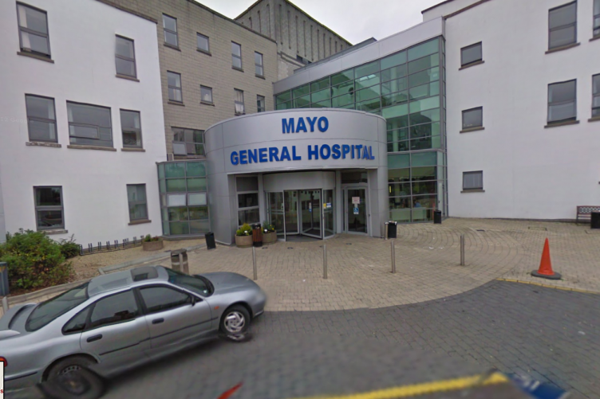
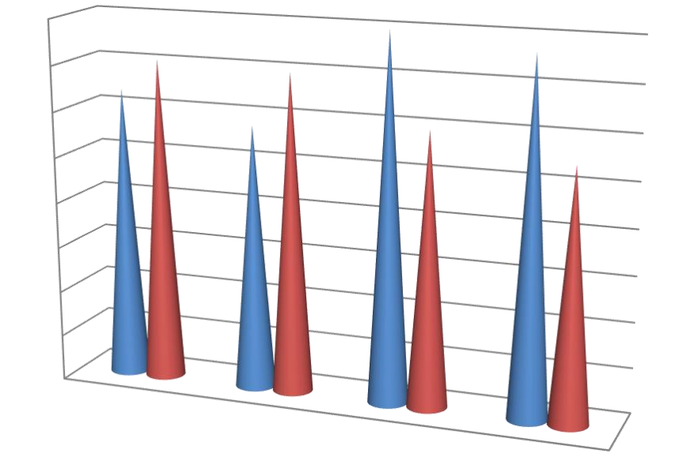
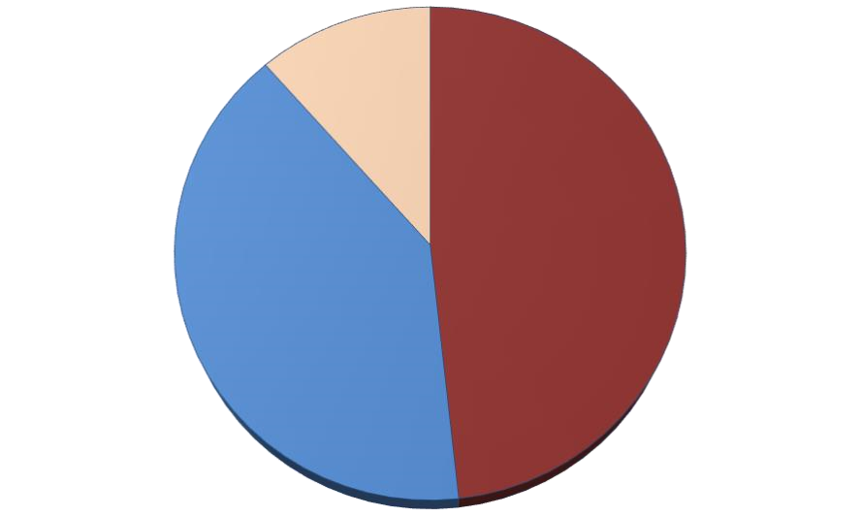
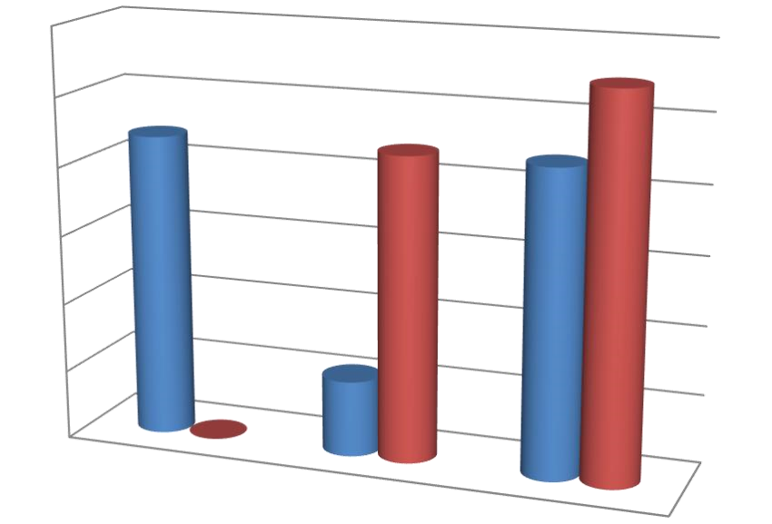
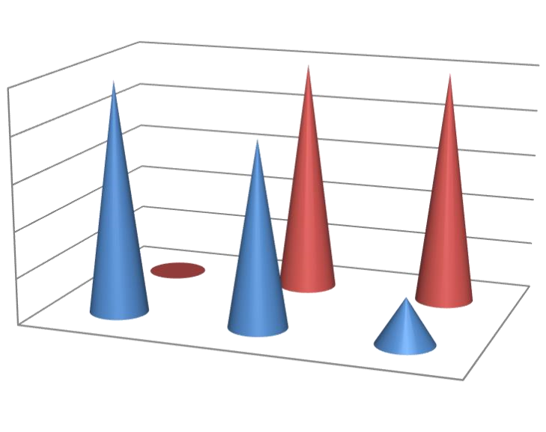
Pre Operative Fasting for Elective Procedures
Mayo University Hospital.
Introduction
Results
Traditionally, patients have been kept ‘nil-by-mouth’ for 12–24 h prior to elective surgical procedures in order to reduce the risk of vomiting and aspiration at induction of anaesthesia.
Overnight fasting may result in hunger, thirst, and anxiety, is difficult for patients to tolerate and is also associated with dehydration. Dehydration, particularly in older adults has been linked with acute kidney injury (AKI) which is associated with poor outcomes. Preoperative fasting also induces metabolic stress leading to the depletion of glycogen stores, the utilisation of muscle protein for gluconeogenesis .
European Society of Anaesthesia Guidelines recommend a fasting time of 2 hours for clear fluids and 6 hours for light diet to reduce these risks.
Mayo University Hospital Department of Anaesthesiology adapted and adopted these guidelines locally in 2019.
This audit looks at local adherence to these guidelines in patients presenting for elective surgery at our hospital
A total of 50 patients were involve in this study, in which 22% were male, 34% were female, 20% were pregnant and 18% were children.
Median fasting hours 6 -12 hrs 48% for solid food and 40% for clear fluid,
52% of patient had prolonged fasting times > 12hrs for solid food and 18% for clear fluid, 42% of patient had clear fluid 2 hrs prior to surgery. 24% hadprescribed carbohydrate drinks < 2 hours before surgery and 18% missed their medication in the morning due to fasting.
Written information about fasting times was received by 64% of patients, verbal discussion of fasting times with patient with or without sending written recommendation were 68% either by surgeon , by phone call or in the pre anaesthesia assessment clinic (PAAC).
Discussion
This prospective audit from MUH demonstrates incomplete compliance to the current policy Patients were fasting from clear fluids and food much longer than is recommended, with the majority of patients undergoing elective surgery fasting >4 h from clear fluids and >12 h from food, these result is against the principles of modern perioperative guidelines, including the enhanced recovery after surgery (ERAS) protocols. The present audit also demonstrates that a significant proportion of patients are fasting for over 12 h before surgery.
The reasons for prolonged preoperative fasting times are likely to be multifactorial. These range from poor staff understanding to challenges with efficiency and theatre scheduling, which therefore impair compliance with guidelines [34]. Patient education, understanding and engagement may also play a key role . It also important to note whilst most patients scheduled for elective operations will receive written information, they are rarely offered an explanation justifying preoperative fasting. This may also contribute to poor compliance .
Patients who have fasted for more than eight hours may find it difficult to eat and drink normally postoperatively. They may also become nauseous and vomit due to excessive fasting and can even contribute to postanaesthetic morbidity.
Also found that carbohydrate-enriched drinks given 90 minutes before surgery pass out of the stomach before surgery without affecting the pH balance, while improving the patient’s well-being and reducing the postoperative recovery period. moreover patients who have fasted for more than eight hours are more prone to hypothermia, due to the loss of heat produced by digestion therefore should make sure that patients are kept warm during surgery if they have fasted for a long period. This is particularly important for children and older people as they have relatively less body fat than healthy adults.
AUTHOR: Dr Khalid Siddig Abdalla Mohamed Ali, SHO Anaesthesiology, Mayo University Hospital
Dr Ciara Canavan, Consultant Anaesthesiologist, Mayo University Hospital.
Methods
80
%
This prospective audit was performed over a month starting from 1/9/2021, for all patient presenting to Mayo University Hospital for an elective surgical procedure from all age groups and surgical specialities which include General Surgery, Obstetrics & Gyneocology, Orthopedics, Dental.
Patients were asked how long they were fasting for clear fluids and solid food, what information they had been given about fasting , written or verbal and whether they had missed medication due to fasting.
70
%
60
%
50
%
40
%
Verbal
30
%
Writing
20
%
10
%
0
%
Adult male
Adult female
Pregnant
Peads
Soft drink
A
B
Adult male
Adult female
Pregnant
Peads
80
%
70
%
60
%
missed medications
50
%
Clear fluid
40
%
Solid food
Peads
30
%
20
%
Pregnant
Adult male
10
%
Adult female
0
%
2
- 6 hrs
6
- 12 hrs
12
- 24 hrs
Adult female
Pregnant
Adult male
Peads
60
%
0
%
5
%
10
%
15
%
20
%
25
%
30
%
35
%
40
%
50
%
40
%
30
%
Clear fluid
Conclusion
20
%
Solid food
10
%
0
%
2
- 6 hrs
6
- 12 hrs
12
- 24 hrs
Despite recommendations to the contrary, patients are still being fasted for six to eight hours or even longer before planned surgery. This is not for the benefit of patients, but to fit in with theatre systems. This is unsatisfactory and does not constitute patient-led care. The time patients need to fast before surgery can be reduced if organisation and communication are improved. Theatre staff should liaise with the surgeon, anaesthetist and ward staff to ensure that patients are fasted for the minimum time required.
50
%
40
%
30
%
Clear fluid
20
%
Solid food
10
%
Solid food
0
%
2
- 6 hrs
6
- 12 hrs
12
- 24 hrs
Clear fluid

