Slide 1
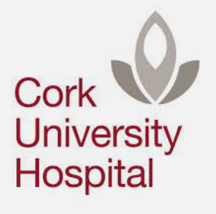
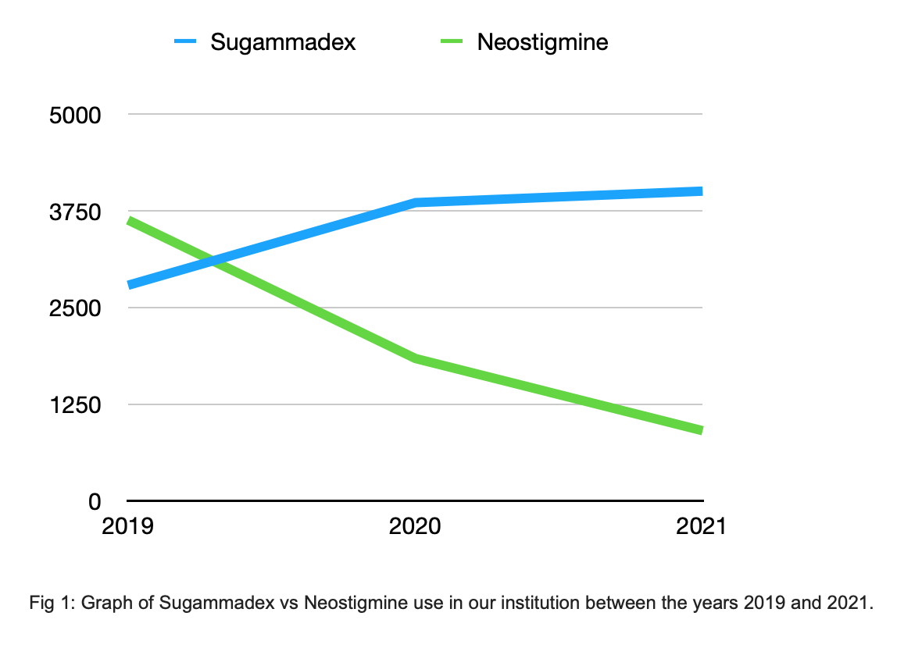
Sugammadex: The future of neuromuscular blockade?
An audit of trend in usage around the COVID-19 pandemic.
Introduction:
Neostigmine has long been the mainstay of reversal of non-depolarising neuromuscular blockade (NDMB). It is, however, not without its limitations. It has an indirect mechanism of reversal, systemic anticholinergic activity and unpredictable efficacy (1). Sugammadex is a newer agent which selectively binds to vecuronium and rocuronium (1)(5).The potential advantages of sugammadex over neostigmine for the reversal of NDMB have been studied and increasingly supported in the literature in recent years. In the context of the COVID-19 pandemic and possible accompanying changes in perioperative management, we set out to analyse the trends in our institution’s usage of these two NMDB reversal agents.
Methods:
We analysed available data from our pharmacy concerning sugammadex and neostigmine use in the years 2019, 2020 and thus far in 2021. We extrapolated the data for 2021 to give an estimate for its use for the entire year.
Discussion:
Sugammadex remains an expensive drug. Unfortunately institutional policies limit its use currently. Sugammadex provides effective and rapid reversal of neuromuscular blockade without the unwanted side effects of neostigmine (3). An increasingly strong body of evidence in the literature supports the view that sugammadex has a superior safety profile. Our findings around our institution’s increased use of sugammadex for reversal of NDMB throughout the pandemic suggests it is increasingly favoured by our consultant staff.
Results:
Use of sugammadex increased >30% between 2019 and projected 2021 (2,786 to 4,003). Between 2019 and 2020 use increased 28% (2786 to 3854). Neostigmine purchasing quartered between 2019 and projected 2021 (3630 to 906) and halved between 2019 and 2020 (3630 to 1840).
Conclusion:
There has been a significant increase in use of sugammadex during the pandemic in our institution. With its advantages over the more traditional agent neostigmine, it is our view that steps should be taken to make Sugammadex more accessible to anaesthetists going forward.
References:
Hristovska AM, Duch P, Allingstrup M, Afshari A: . Efficacy and safety of sugammadex versus neostigmine in reversing neuromuscular blockade in adults. Cochrane Database Syst Rev . 2017; 8:CD012763
Kirmeier E, Eriksson LI, Lewald H, Jonsson Fagerlund M, Hoeft A, Hollmann M, Meistelman C, Hunter JM, Ulm K, Blobner M; POPULAR Contributors: Post-anaesthesia pulmonary complications after use of muscle relaxants (POPULAR): A multicentre, pro- spective observational study. Lancet Respir Med 2019; 7:129–40
Kheterpal S, Vaughn MT, Dubovoy TZ, Shah NJ, Bash LD, Colquhoun D, Shanks AM, Mathis M, Soto RG, Bardia A, Bartels K, McCormick P, Schonberger RB, Saager L: . Sugammadex versus neostigmine for reversal of neuromuscular blockade and postoperative pulmonary complications (STRONGER): A multicenter matched cohort analysis. Anesthesiology . 2020; 132:1371–81
Somnath Bose, Xinling Xu and Matthias Eikermann: Does reversal of neuromuscular block with sugammadex reduce readmission rate after surgery? British Journal of Anaesthesia, 122 (3): 294e298 (2019)
Nag K, Singh DR, Shetti AN, Kumar H, Sivashanmugam T, Parthasarathy S. Sugammadex: A revolutionary drug in neuromuscular pharmacology. Anesth Essays Res. 2013;7(3):302-306. doi:10.4103/0259-1162.123211

