Slide 1
Patient Safety Culture in the Obstetric Environment
Dr Andrew O’Donoghue - Specialist Anaesthesia Trainee
National Maternity Hospital, Holles Street

Slide 2
Contents
Patient Safety Culture and why is it worth exploring?
Safety Attitudes Questionnaire
What we saw in our unit and how it compares
What next?

Slide 3
Why is this important?
Two patients
Different specialties, different levels of experience
High stakes
High stress
High expectations
Notes:
A unique multidisciplinary setting
Changing hierarchies, agendas and stake holders every shift.
Both anaesthesia and obstetrics

Slide 4
Safety Attitudes Questionnaire¹
“A snapshot of an organisation’s safety culture through survey of front line workers’ perspectives…”

Slide 5
Study Characteristics
Cross-sectional quantitative survey of our theatre department
35 item questionnaire
6 subscale themes and 4 non themed individual questions
Anonymous
One page… (Double-sided!)
Option to declare:
Grade/Role
Gender
Experience in specialty

Slide 6
Sub-Scale Themes²
1
Teamwork Climate
4
Stress Recognition
2
Safety Climate
5
Perceptions of Management
3
Job Satisfaction
6
Working Conditions
Notes:
Questionnaire can be grouped under the following themes,
described by Vincent and Colleagues
as organisational factors that influence clinical practice,

Slide 7
Results
Mean likert response
Percentage of respondents in agreement

Slide 8
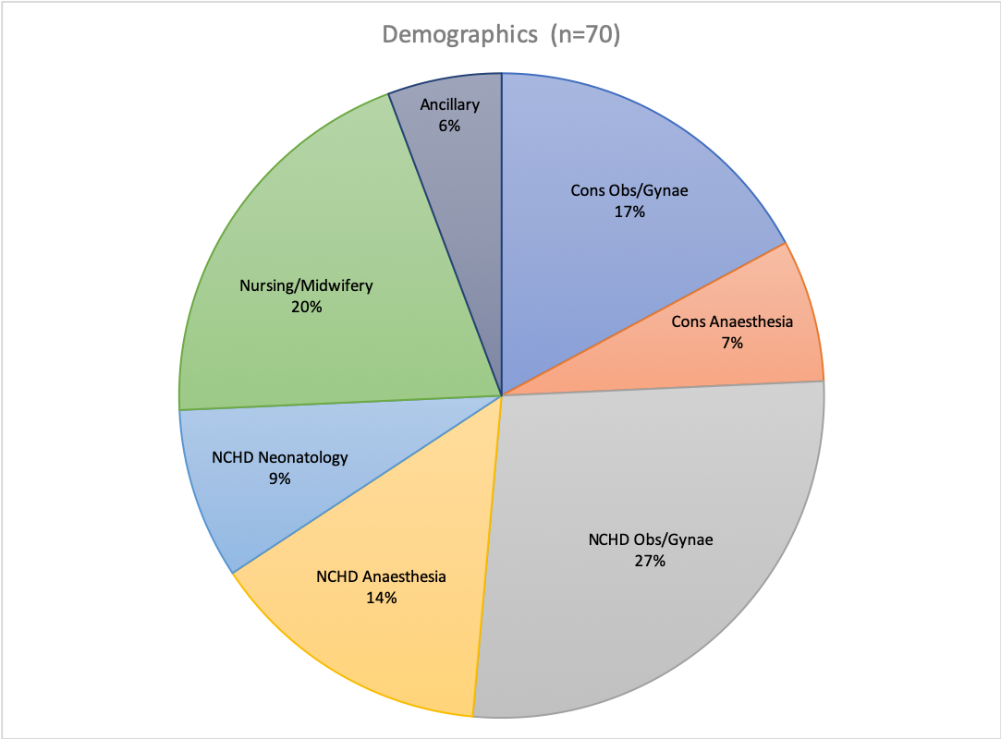
Population and response rate
Theatre unit in our institution
Consultant and NCHD Obs/Gynae
Consultant and NCHD Anaesthesia
NCHD Neonatology
Nursing/Midwifery Staff
Ancillary Staff (HCAs and Porters)
Response rate 79%

Slide 9
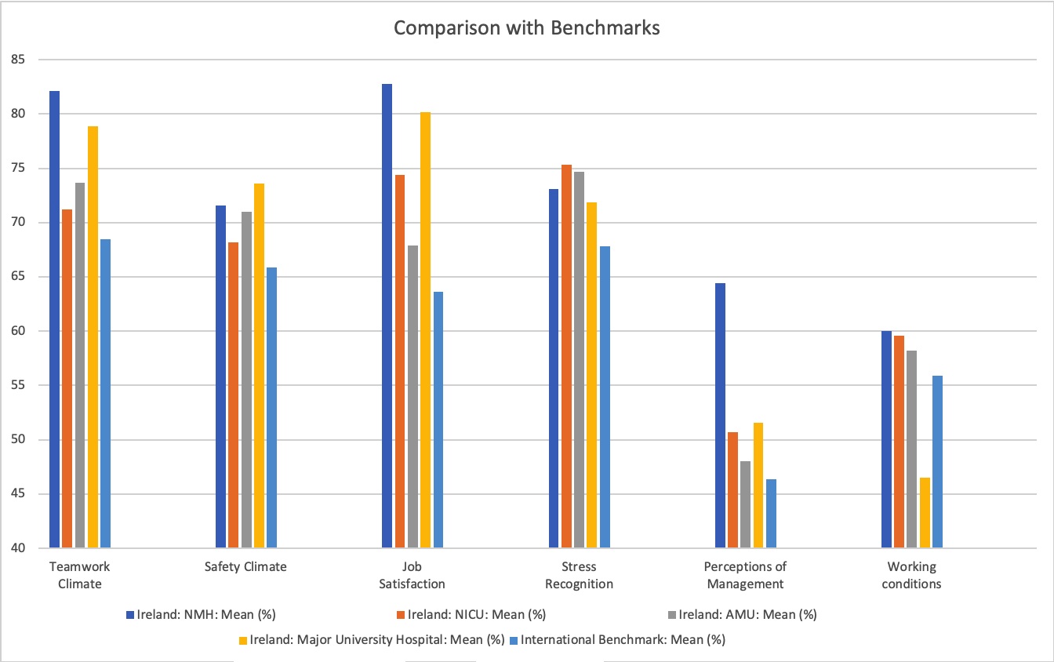
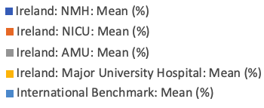
Comparison with Benchmarks

Slide 10
Key Findings
Positives
Teamwork Climate
Perceptions of Management
Opportunities for Improvement
Stress Recognition
Working Conditions

Slide 11
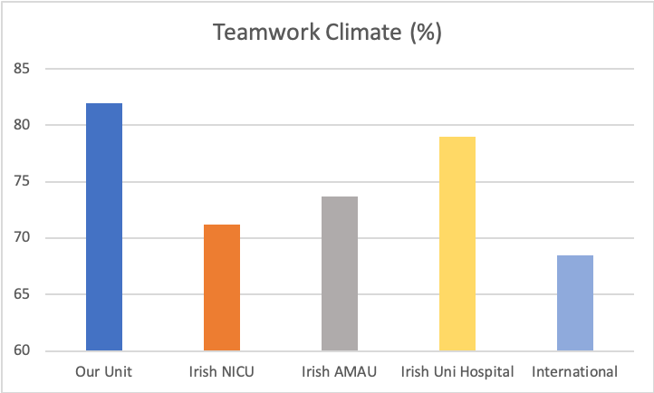
Teamwork Climate
Quarterly PROMPT simulations
PRactical
Obstetric
MultiProfessional
Training
Simulations shown to improve ³
Teamwork Climate
Communication
Clinical outcomes
Notes:
One theme in which our institution outperformed the comparison studies, was teamwork climate.
We hypothesise that this is due to a culture of quarterly simulation, usng PROMPT framework
This involves all stakeholders similating obstetric emergencies in a safe environment
Debrief allows learning.
Improved outcomes have been shown in the literature.
PROMPT: PRactical Obstetric MultiProfessional Training (Course in a box)
Maternal collapse, seizures in pregnancy, PPH and sepsis
Representatives from clinical disciplines: Obs/Gynae, Anaesthesiology, Nursing/Midwifery
Siasskos -

Slide 12
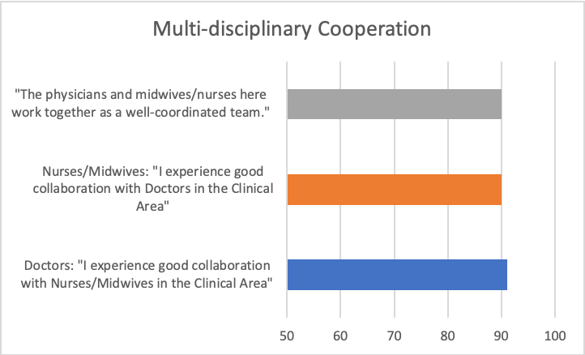
Teamwork Climate
Reciprocity not reflected in the literature^{4,5}
MDT clinical simulations
Soft strategies unique to our institution
Size of institution
Multidisciplinary doctors residence
Social outings
Established culture
% agreeing with statement
Notes:
MDT clinical simulations
Soft strategies unique to our institution
Size of institution
Multidisciplinary doctors residence
Social outings
Established culture
Relihan (AMAU)
Makary (american institution)

Slide 13
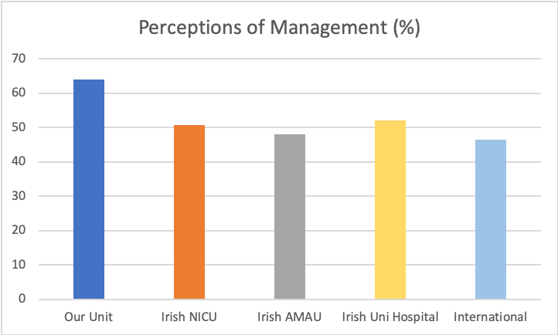
Perceptions of Management
“Mastership” model
Developed in Dublin in 1745 upon establishment of Rotunda by Bartholomew Mosse
Clinical management by practicing consultant
Notes:
Arguably, This could be attributed to

Slide 14
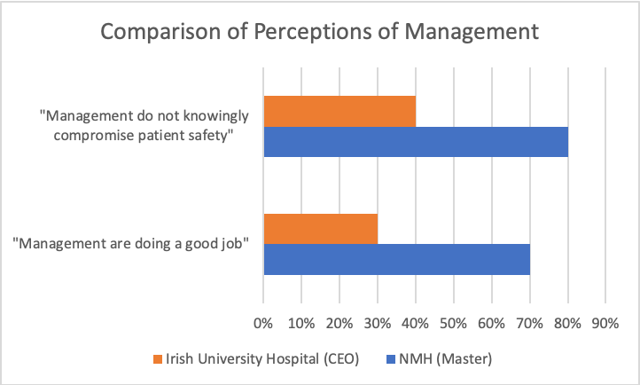
Perceptions of Management

Slide 15
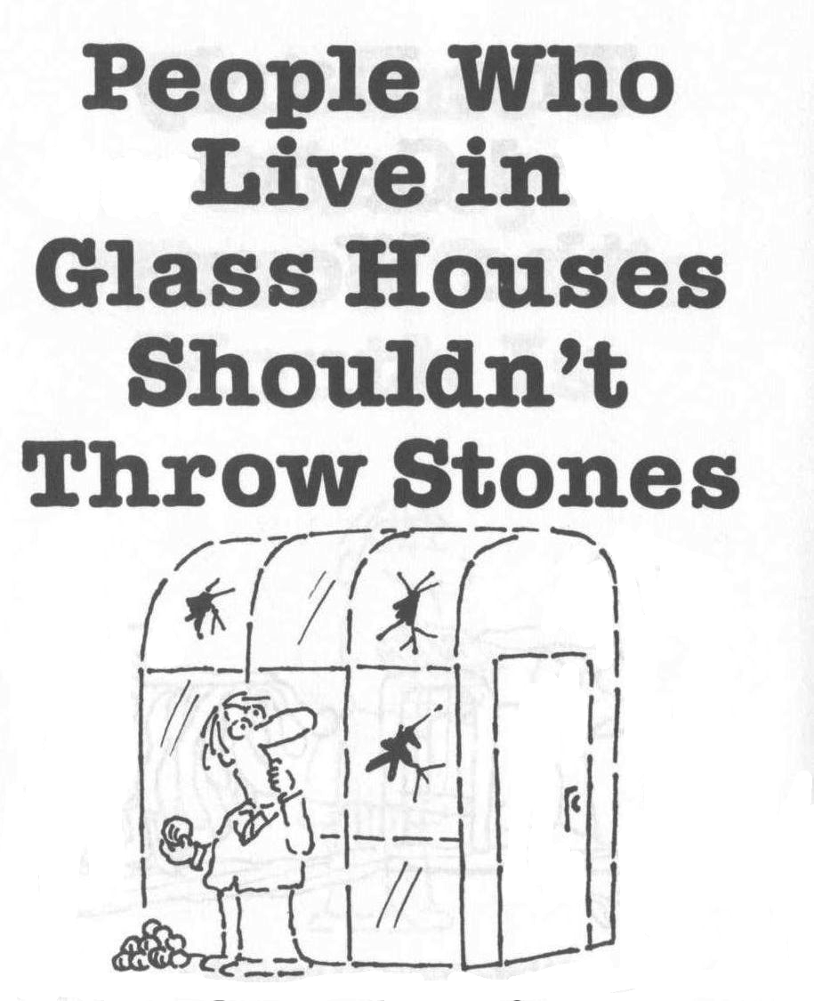

Slide 16
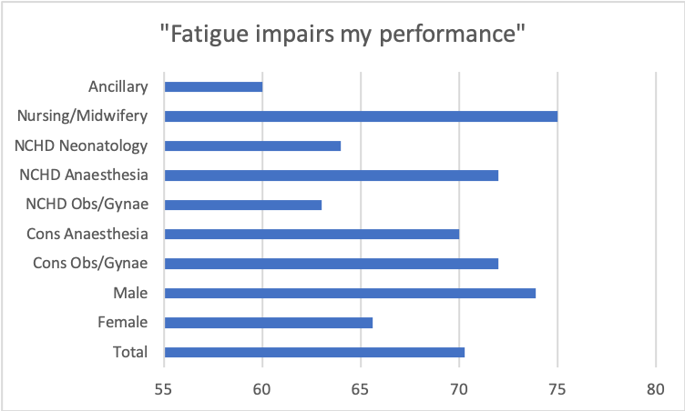
“Fatigue impairs my performance” Agree or Disagree...
Female
Obs/Gynae NCHD
Neonate NCHD
HCAs and Porters
(%)

Slide 17
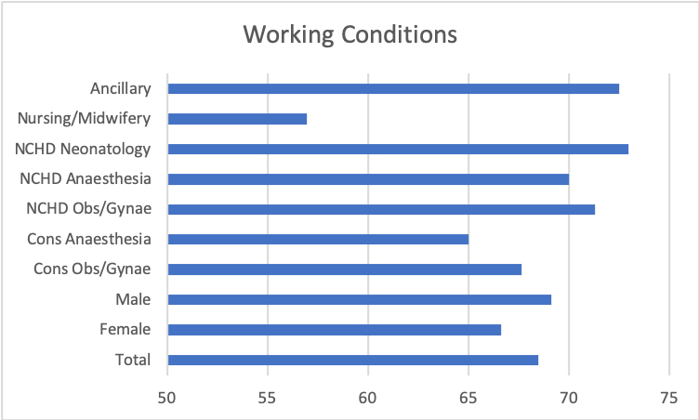
Working Conditions
(%)

Slide 18
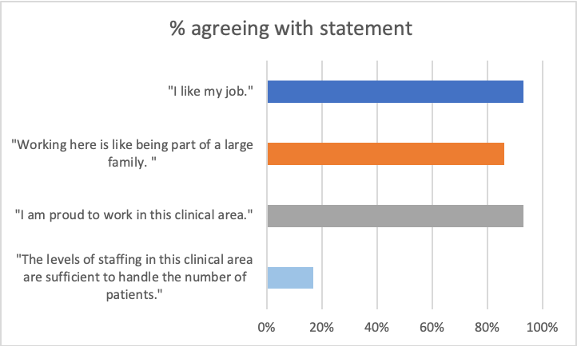
Staffing Levels
More negative in NMH than elsewhere
Increase in medical/nursing staff levels ∝ decreased mortality ⁶
Notes:
Griffiths - cross sectional national NHS study- UK WIDE

Slide 19
2011
2013
2020
Notes:
Poor staffing has been identified as a key contributor to each of these critical incidents

Slide 20
Summary
Teamwork Climate
Perceptions of Management
Perception of Fatigue
Working Conditions
Notes:
It is possible to demonstrate the culture of an institution quantitatively. Patient safety culture is an overlooked method of improving outcomes for patient and it is possible to improve it in a targeted manner.
Particularly relevent to

Slide 21
What next?
Multi-centre
Education in aspects requiring improvement
Perceptions of Fatigue
Wellness
Self care
Lobby for improved staffing levels

Slide 22
Thank you.

Slide 23
References
Sexton J, Helmreich R, Neilands T, Rowan K, Vella K, Boyden J, et al. The Safety Attitudes Questionnaire: Psychometric Properties, Benchmarking Data, and Emerging Research. BMC Health Serv Res. 2006;6:44.
Vincent CA, Taylor-Adams S, Stanhope N: Framework for analyzing risk and safety in clinical medicine. British Medical Journal 1998, 316:1154-1157.
Siassakos D, Fox R, Hunt L, Farey J, Laxton C, Winter C, et al. Attitudes Toward Safety and Teamwork in a Maternity Unit With Embedded Team Training. American Journal of Medical Quality. 2010;26(2):132-7.
Relihan E, Glynn S, Daly D, Silke B, Ryder S. Measuring and benchmarking safety culture: application of the safety attitudes questionnaire to an acute medical admissions unit. Ir J Med Sci. 2009;178(4):433-9.
Makary MA, Sexton JB, Freischlag JA, Holzmueller CG, Millman EA, Rowen L, et al. Operating Room Teamwork among Physicians and Nurses: Teamwork in the Eye of the Beholder. Journal of the American College of Surgeons. 2006;202(5):746-52
Griffiths P, Ball J, Murrells T, Jones S, Rafferty AM. Registered nurse, healthcare support worker, medical staffing levels and mortality in English hospital trusts: a cross-sectional study. BMJ Open. 2016;6(2):e008751

