Slide 1
Erector Spinae Plane Block versus Serratus Anterior Plane Block for Quality of Recovery and Morbidity after Minimally Invasive Thoracic Surgery: A Prospective, Randomised, Double-Blind Clinical Trial.
Dr Dylan Finnerty FCAI FJFICMI
Anaesthesiology Research Fellow
Mater Misericordiae University Hospital
Delaney Medal Presentation
16th June 2020

Slide 2
Acknowledgements
Co authors- Dr. Aisling Mc Mahon, Dr. John McNamara, Dr. Sean Hartigan, Dr. Michael Griffin, Prof Donal Buggy
Thoracic Surgeons- Prof K Redmond, Prof D Eaton
MMUH Anaesthesia Nurses
Patients for their participation in this trial

Slide 3
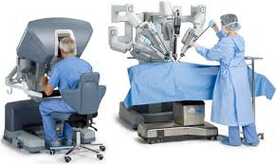
Background
Minimally Invasive Thoracic Surgery (MITS)
Severe Post operative pain
Serratus Anterior Plane Block- current standard
Can we do more for our patients?

Slide 4
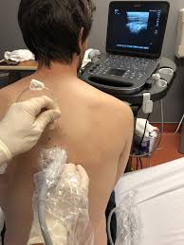
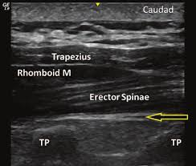
Erector Spinae Plane Block
Interfascial plane block
First described by Mauricio Forrero in 2016
“Paravertebral by proxy”?
Widely popular despite limited evidence
No published RCT of ESP in MITS
Forero M, Adhikary SD, Lopez H, et al. The erector spinae plane block: a novel analgesic technique in thoracic neuropathic pain. Reg Anesth Pain Med 2016;41(5):621-27.

Slide 5
Hypothesis: ESP provides superior quality of recovery and analgesia compared to SAP
Ethical approval: MMUH IRB 1/378/2039
Clinical Trials.gov NCT 0386261
Randomised 60 patients to ESP or SAP over 11 month period
Primary outcome: Quality of Recovery at 24 hours

Slide 6
RESULTS
15 questions assessing patients recovery experience
Standardised and reproducible
5 domains- Pain, physical comfort, physical independence, psychological support, emotional state
150 max score, 0 min score
Minimum clinically important difference = 8
Primary Outcome | ESP | SAP | P value
QoR 15 score | 114 (16) | 102 (22) | 0.02
Myles PS, Myles DB, Galagher W, et al. Minimal clinically important difference for three quality of recovery scales. Anesthesiology: The Journal of the American Society of Anesthesiologists 2016;125(1):39-45

Slide 7
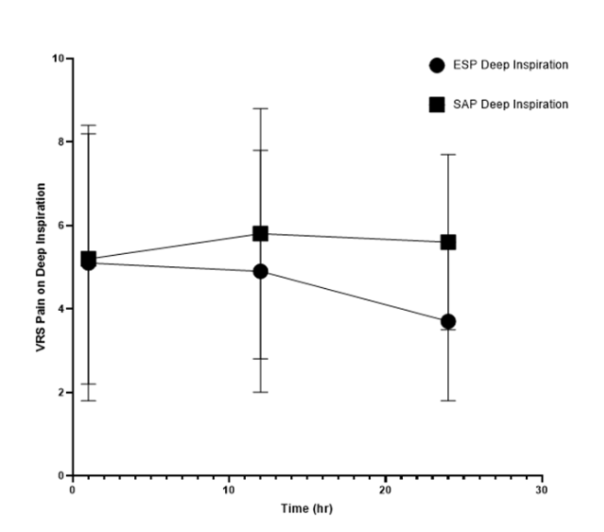
Secondary Outcomes | ESP | SAP | p value
AUC Pain VRS versus time (at rest) | 92 (31) | 112 (35) | 0.03
AUC Pain VRS versus time (on deep inspiration) | 107(32) | 129 (32) | 0.01
Time (min) to first opioid analgesia in PACU | 32.6 (20.6) | 12.7 (9.5) | 0.003
Total postoperative opioid consumption (mg) at 24 hours | 29.3 (31.1) | 39.9 (34.3) | 0.24
Length of stay (days) | 3 (2-6) | 6 (3-9) | 0.17
Comprehensive Complications Index (CCI) | 1 (0-2) | 4 (0-26) | 0.03
Results
Area under the curve (AUC) of Pain VRS versus time (at rest)
*P=0.03
*
Area under the curve (AUC) of VRS Pain versus time (Deep Inspiration)
*P= 0.01
*

Slide 8
Conclusion
ESP assoc. with superior recovery and analgesia
Trend towards ↓ LOS and morbidity

Slide 9
Strengths of this trial
Double blinded, prospective randomised trial
Patient centred Primary Endpoint recommended by a recent STeP publication (Myles 2018)
Includes traditional endpoints
Addressed a knowledge gap
First published RCT of ESP vs SAP (QoR) - British Journal of Anaesthesia (accepted June 11th 2020)
Myles PS, Boney O, Botti M, et al. Systematic review and consensus definitions for the Standardised Endpoints in Perioperative Medicine (StEP) initiative: patient comfort. British journal of anaesthesia 2018;120(4):705-11.

Slide 10
Summary
RCT comparing 2 forms of Regional Anaesthesia
Original clinical research
Patient focus
Local and International Impact

