Slide 1
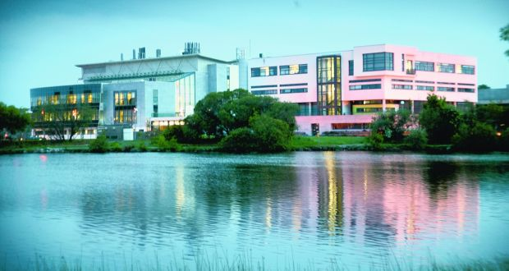




Investigation of the Therapeutic Potential of Mesenchymal Stem/Stromal Cells in Preclinical Models of Systemic Sepsis
Dr Colm Keane
Department of Anaesthesiology,
National University of Ireland, Galway
Notes:
Good evening. My name is Colm Keane. Thank you for the opportunity to present my research investigating the therapeutic potential of mesenchymal stem cells in preclinical models of systemic sepsis.

Slide 2
Sepsis and MSC’s
Syndrome of life threatening physiologic, pathologic, and biochemical abnormalities resulting from infection
Consequence of an abnormal host immune response.
Mesenchymal Stem Cells (MSCs) have considerable promise as a therapy for Sepsis
Key Translational Challenges for MSCs in Sepsis
  key mechanisms of action unclear
  optimal MSC tissue source not known
  efficacy following cryopreservation
Notes:
Sepsis is a syndrome of life threatening physiologic, pathologic, and biochemical abnormalities resulting from infection.
It is the consequence of an abnormal and unregulated host immune response.
Mesenchymal Stem Cells or MSCs have considerable promise as a therapy for sepsis.

Slide 3
Keane et al. Anaesthesiology, 2017
Notes:
In this schematic, from our review article in Anaesthesiology, we outline the beneficial effects MSCs exert on organ systems through their interaction with cells of the innate and adaptive immune systems.
Enhanced endothelial repair, through mitochondrial transfer, allows for tissue inflammatory milieu gate keeping. M2-like macrophages enhance complement activation, increase microbe phagocytosis and clearance, and increase targeted neutrophil recruitment to injured tissue. The targeted control of microbial invasion is further influenced by Inflammasome/Caspase-1 deactivation, and an increased regulatory T-lymphocyte presence.

Slide 4
Sepsis and MSC’s
Syndrome of life threatening physiologic, pathologic, and biochemical abnormalities resulting from infection
Consequence of an abnormal host immune response.
Mesenchymal Stem Cells (MSCs) have considerable promise as a therapy for Sepsis
Key Translational Challenges for MSCs in Sepsis
  Key mechanisms of action unclear
  Optimal MSC tissue source not known
  Efficacy following cryopreservation unclear
Notes:
Some key translational challenges remain for MSCs in sepsis:
1. Some key mechanisms of action remain unclear
2. The optimal MSC tissue source is not known
3. And Efficacy following cryopreservation is unclear.

Slide 5
Overall Aims
Aim to address the key Clinical Translational Challenges for MSCs in Sepsis
  Mechanism of Action – Determine the potential for MSCs to enhance monocyte/macrophage-mediated bacterial killing
  MSC Source – compare the efficacy of Bone marrow (‘gold standard’) versus Umbilical Cord (more available) MSCs
  MSC Cryopreservation – determine if MSCs retain efficacy following cryopreservation (to enable storage for clinical use)
Do cryopreserved Umbilical Cord-MSCs function comparably to Fresh Bone Marrow-MSCs in a clinically relevant sepsis model?
Notes:
We therefore aimed to address these key Clinical Translational Challenges for MSCs in Sepsis:
Regarding mechanism of action: to determine the potential for MSCs to enhance monocyte/macrophage-mediated bacterial killing
MSC Source: to compare the efficacy of Bone marrow versus Umbilical cord MSCs
MSC Cryopreservation: to determine if MSCs retain efficacy following cryopreservation
And ultimately, do cryopreserved Umbilical Cord-MSCs function comparably to Fresh Bone Marrow-MSCs in a clinically relevant sepsis model?

Slide 6
Experimental Approach
In vitro experiments to determine the potential for MSCs to enhance monocyte/macrophage-mediated bacterial killing
Characterization and validation of a clinically relevant sepsis model
  Rodent caecal ligation and puncture (CLP)-induced severe systemic sepsis
Determination of MSC Efficacy in CLP-induced Sepsis
  MSCs versus Vehicle
  Umbilical cord versus Bone Marrow MSC Source
  Cryopreserved versus Fresh MSCs
Notes:
Our experimental approach was therefore three-phased:
In vitro to determine the potential for MSCs to enhance macrophage-mediated bacterial killing
Characterization and validation of a clinically relevant sepsis model: in this case, rodent caecal ligation and puncture-induced severe systemic sepsis
Finally, determination of MSC Efficacy in CLP-induced Sepsis by assessing: MSCs versus Vehicle, Umbilical cord versus Bone Marrow MSC Source, and Cryopreserved versus Fresh MSCs

Slide 7
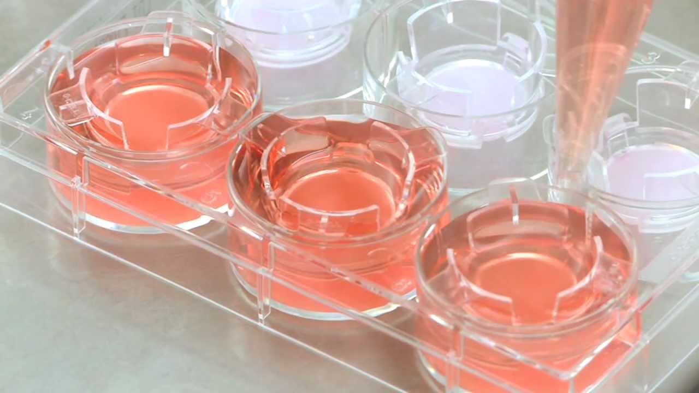
In vitro:
MSCs
THP-1 monocytes
E.Coli
Notes:
In vitro, pre-activated MSCs, in co-culture with THP-1 human monocytes, were used to assess phagocytic potential against E. coli bacteria.
We assessed MSC activation using ELISA, and E. coli phagocytosis using spectrophotometry.

Slide 8

In Vitro
MSC Mechanism of Action
Notes:
We first looked at MSCs in vitro to assess efficacy and mechanism of action.

Slide 9
Notes:
Activation of MSCs resulted in significantly increased MSC secretion of Interleukin -6 and 8. In Panel B, we can see that the MSC-monocyte co-culture to have produced significantly more IL-6 than control or monocyte-only groups.

Slide 10
Notes:
In the spectrophotometry experiments, we assessed if MSCs enhanced phagocytosis. Looking at slide E for example, 4 groups were used: two control groups, monocytes alone, and the MSC-monocyte co-culture, and E.Coli phagocytosis is demonstrated on the y-axis in colony forming units. As you can see in panels B, C, E and F, MSCs significantly enhanced macrophage E. coli phagocytosis, whether cell-cell contact was inhibited or not. This was the case for bone marrow MSCs here,

Slide 11
Notes:
and umbilical cord MSCs in this identical experiment.

Slide 12
Caecal Ligation and Puncture Model Validation
Notes:
Prior to the therapeutic series, we needed to re-establish the Caecal Ligation and Puncture Model of Systemic Sepsis, previously used in our laboratory.

Slide 13
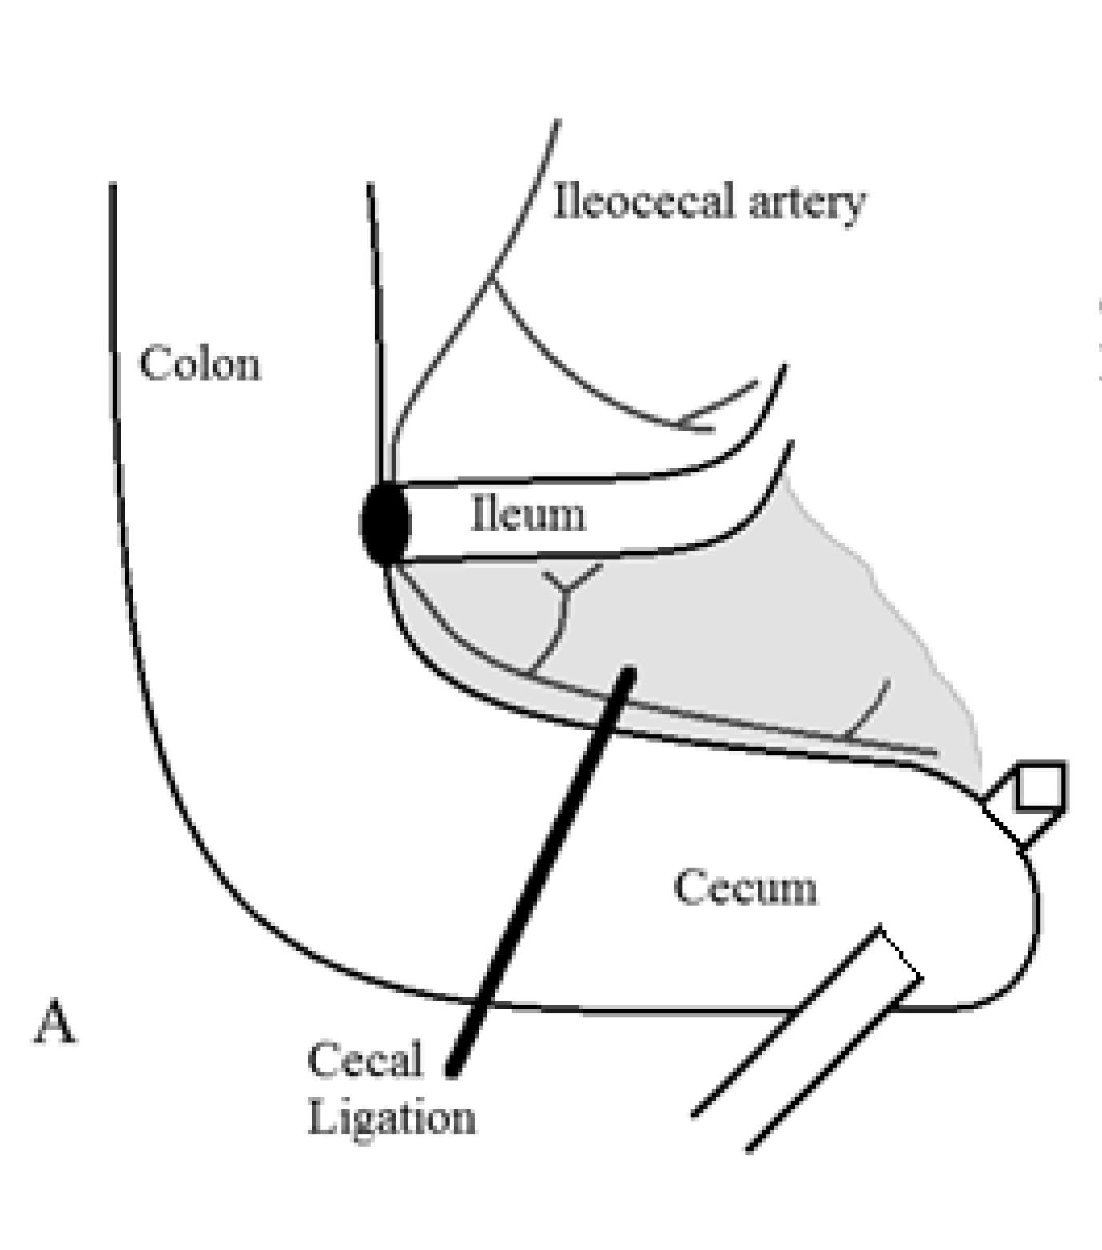
Caecal Ligation and Puncture
Notes:
Our aim was to establish a significant systemic injury by varying the percentage of caecal ligation, and the number or size of the puncture sites.
An issue that developed was the resealing of the caecal puncture due to the flap of tissue remaining from needle puncture. We therefore developed a novel puncture method for the CLP model which we subsequently validated prior to the therapeutic series.

Slide 14
Notes:
Markers of significant injury included lactataemia and arterial CO₂ .

Slide 15
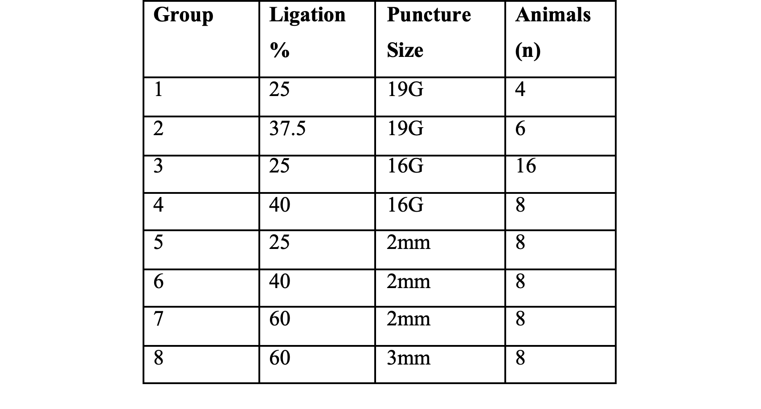
CLP Groups
Notes:
We determined that a caecal ligation of 60% combined with a puncture of 2mm diameter provided significant and reproducible systemic sepsis-induced injury in this pilot series.

Slide 16
Efficacy of
Cryopreserved (Umbilical Cord) vs Fresh (Bone Marrow) MSCs
Notes:
We then brought this novel injury model to our therapeutic series with the aim of comparing efficacy of cryopreserved vs fresh MSCs.

Slide 17
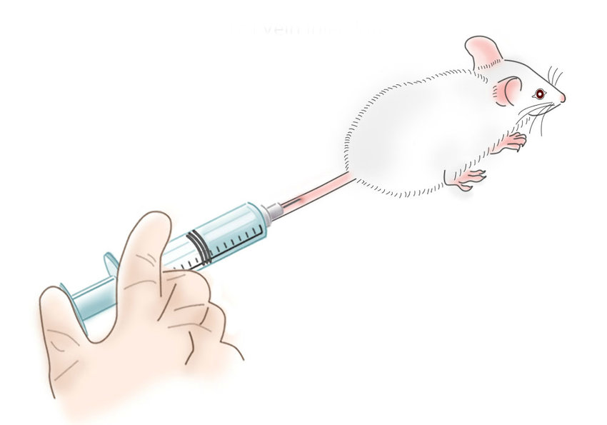
MSC’s in vivo
CLP
Fresh Bone Marrow
Cryopreserved Umbilical Cord
Vehicle control
Notes:
Using our novel CLP injury, the therapeutic series then compared the efficacy of fresh bone marrow and cryopreserved Umbilical cord MSCs, administered intravenously at the time of injury. Vehicle control was used and animals were assessed for indices of recovery 48 hours following injury.

Slide 18
Notes:
MSC therapy significantly increased survival duration, and overall survival, as can be seen in the Kaplan Meier curve, compared to control treatment.

Slide 19
Notes:
MSC therapy significantly attenuated CLP sepsis, reducing bacterial growth overall in both liver and spleen cultures. In panel A, therapeutic groups are represented on the x-axis, with bacterial colony forming units on the y-axis.

Slide 20
Notes:
MSCs significantly attenuated growth of klebsiella pneumoniae, enterococcus faecalis and E. coli in liver cultures on the left column, and klebsiella pneumoniae in splenic cultures on the right. Again, therapeutic groups are represented on the x-axis, with bacterial colony forming units on the y-axis.

Slide 21
Notes:
Secondary analysis showed comparable efficacy of cryopreserved versus freshly harvested MSCs regarding survival duration and overall survival

Slide 22
Notes:
And comparability in attenuation of bacterial growth in both liver and spleen homogenate cultures.

Slide 23

Key Findings
Mechanism – MSCs enhance macrophage pathogen killing in vitro, both directly (contact-dependent), and indirectly (contact-independent)
Model - We developed and validated a novel model of rodent CLP-induced severe systemic sepsis
MSC Source – Umbilical cord derived MSCs were as effective as bone marrow derived MSCs in attenuating sepsis
Cryopreservation - Cryopreserved MSCs reduced organ bacterial growth, attenuated shock severity, and increased animal survival
This data will form a key component of a dataset for translation of cryopreserved Umbilical Cord-derived MSCs to Phase I trials in Systemic Sepsis
Notes:
Our research has therefore demonstrated several key findings:
MSCs enhance macrophage-mediated pathogen killing in vitro
We developed and validated a novel model of rodent CLP-induced severe systemic sepsis
Umbilical cord derived MSCs were as effective as bone marrow derived MSCs in attenuating sepsis
Cryopreserved MSCs reduced organ bacterial growth, attenuated shock severity, and increased animal survival
Ultimately, This data will form a key component of a dataset for translation of cryopreserved Umbilical Cord-derived MSCs to Phase I trials in Systemic Sepsis

Slide 24
Thank you
Notes:
Thank you for your time.

